Slide 1
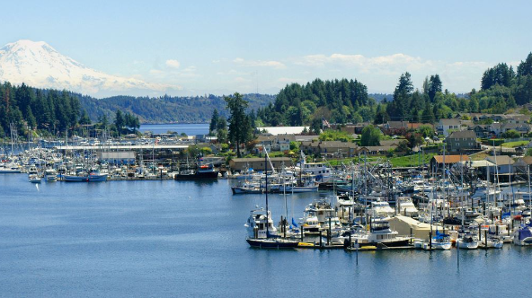
Community Listening Session 2024 Comprehensive Plan Periodic Update Land Use ELEMENT & MAP June 26, 2024
Notes:
Welcome and thank you so much for coming out. It is always a bit of a roll of the dice to see who finds comprehensive planning compelling enough to come to one of our events. Perhaps not super exciting-sounding, but very important for those who are keen to have a voice in shaping the future of Gig Harbor!

Slide 2
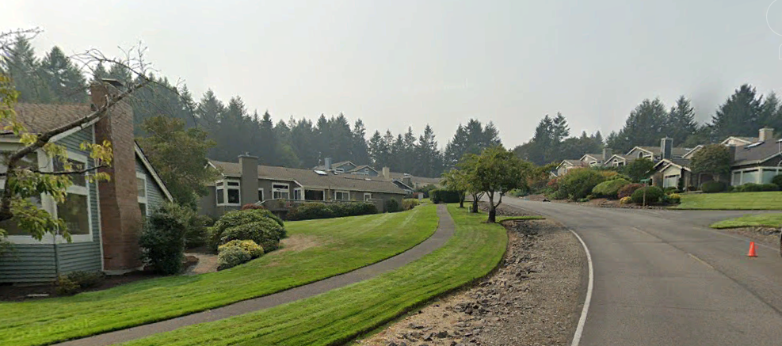
Listening Session
Agenda
Comprehensive Plan Overview
Timeline and process
Introduction of the Land Use Element
Next Steps
Questions/Discussion
Notes:
Here is what is on tap for this aafternoon/evening: I will give you a very rough overview of the comprehensive plan, why we need to update it, the timeline and then we are going to discuss one of the 13 elements – Land Use. We start with land use because it informs virtually every aspect of city planning – from housing and employment, to transportation, the environment and infrastructure. The handouts we have provided include an audit of the existing land use element and the draft element itself. This is not in stone – we have a ways to go before it is in its final form, but I wanted to give the community a chance to take a peek and let us know what you think.

Slide 3
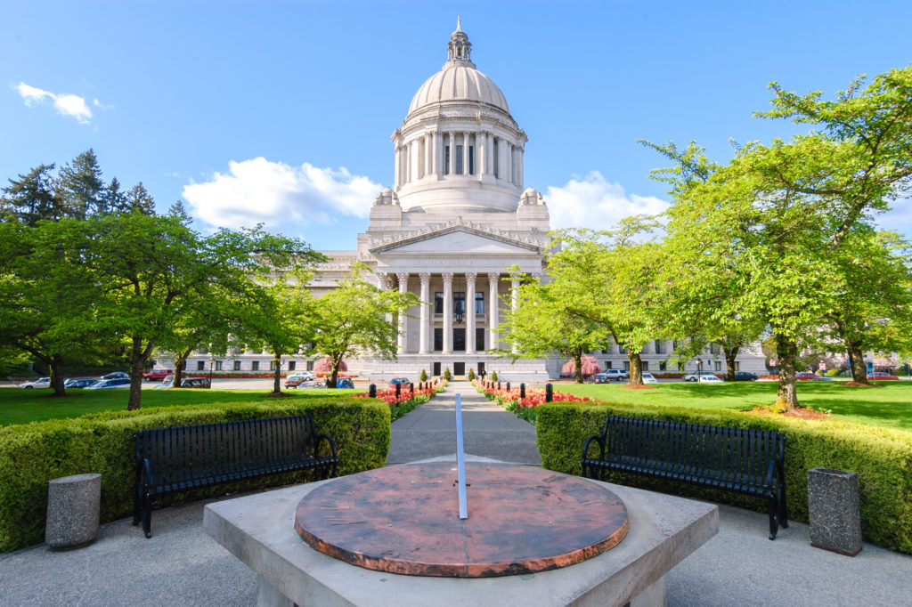
Comprehensive Plan - Basics
Created under the 1990 Growth Management Act
Centerpiece of local land use planning efforts
Informs all land use decisions (e.g. commercial/industrial/residential development, supporting infrastructure)
Thirteen Elements
Updates required every 10 years
Increase in population triggers upgrades to infrastructure, housing/employment needs
New legislation
Review of community vision and priorities
Notes:
The Comprehensive plan is truly the ceterpiece of local land use planning and was created under the washiington state growth management act, first enacted in 1990. Again, the elements that make up the plan encompass all land use deicsions. The plan is required by the state to be updated every 10 years. The update is necessary for two reasons – one to project what level of population growth we expect to see and to accommodate that growth by ensuring that we have enough housing, jobs, road network, parks and trails, and more.

Slide 4

Legislative Changes
HB 1220 requires cities to:
Evaluate policies and regulations to accommodate the City’s population of low and very-low-income households
Address racially disparate impacts,
Address housing displacement and exclusion, identify areas that are at a higher risk of displacement,
Establish anti-displacement policies
HB 1337 requires cities to allow ADUs by right in all residential zone districts, subject to some restrictions.
In effect June 2025
Notes:
Why do we need to update? In addition to Population growth the state legislature – in its infinite wisdom – enacts legislation that requires changes to our plan. Two recent examples include HB 1220 and HB 1337

Slide 5
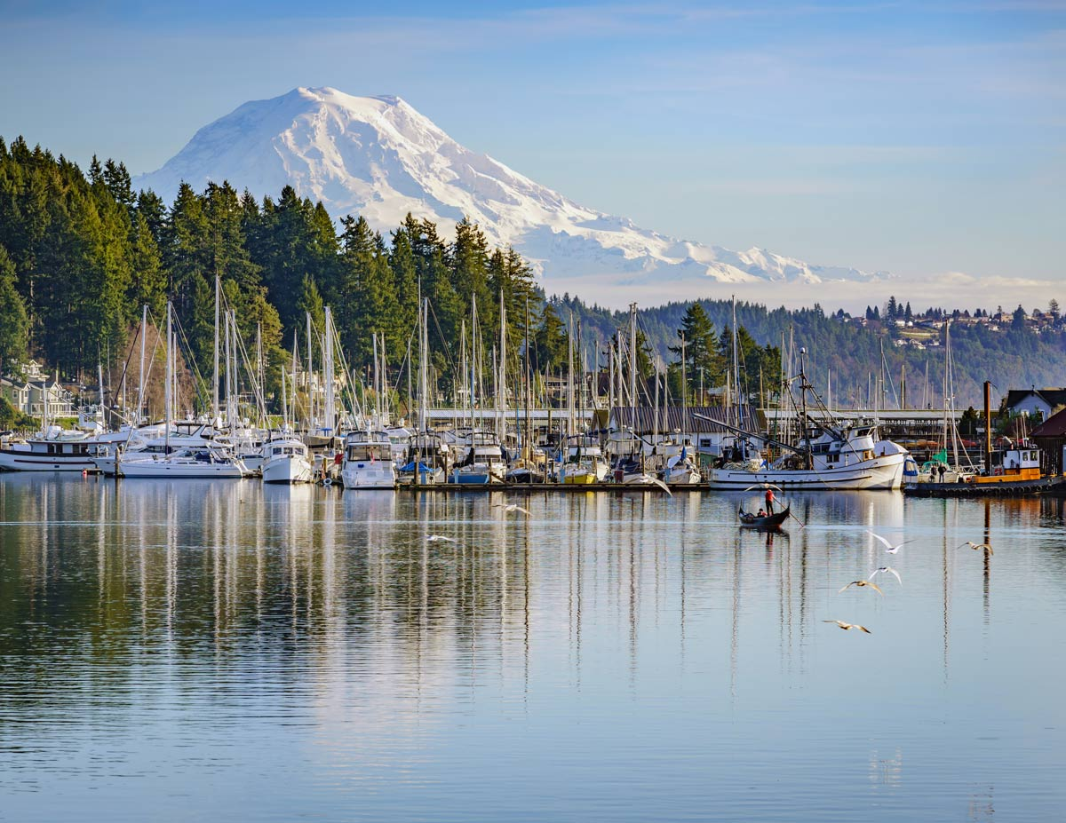
Timeline
Develop Work and Engagement Plan
February 2023
Public Noticing & Public Hearings
October 2024
Plan Adoption & Publishing
December 2024
SEPA Determination & Submittal to Commerce
October 2024
Begin Public Outreach & Noticing
April 2023
Data Gathering & Analysis
June 2023
Begin Draft Element Review (PC/CC)
June 2024
Notes:
We started this project last February with a workplan and a public engagement plan – public input is fundamental to this process. We began our outreach efforts last April and that will continue through the end of the process – the update is required to be completed by December 31st of this year. Beginning last summer, our consultant started gathering data and analysing the eisting plan to determine what changes are either necessary or desired. And this month we began the job of drafting specific elements for review and revision. Public hearings will begin in October, as well as the SEPA determination and, again, the plan must be adopted in December.

Slide 6
Public Outreach Themes
What is our vision for 2044?
The vision: what should Gig Harbor look like in 2044?
Identifying Issues
What are the policy concerns we need to address in our update?.
Consistency
Are our goals and policies consistent with one another?
Scenarios
What policy options/changes do we need to incorporate
Review and Adoption
Notes:
We started the process by asking the community to give us their vision for Gig Harbor in 2044, identifying key issues. Our comp Plan must be consistent with county and regional planning policies. We then developed three scenarios with a slightly different emphasis on where future growth should occur in the city. One scenario was selected based on an event held last December and a follow –up mailed survey (150 respondents!) We will talk more about the visioning process in a minute. The emphasis of this listening session is the Land Use Element.
We are now in the home stretch – drafting the updated elements and talking about them. The plan must be adopted by December 31st of this year. Gulp.

Slide 7
Proposed general distribution and general location and extent of the uses of land
Population densities, building intensities, and estimates of future population growth
Groundwater / aquifer protection
Promotion of physical activity
Review of drainage, flooding, stormwater runoff (included in Environment Element)
Land Use Element
Requirements
Notes:
As I said, we start with the Land Use Element as it provides the overall foundation for how we coordinate and balance development in the City – jobs/housing/transportation/environmental protection, etc. The element includes a detailed map that shows the different land use categories across the city’s Urban Growth Area. The requirements here come from the Washington Administrative Code and primarily focus on the distribution of land uses throughout the city. The analysis includes expected population growth, and also addresses issues related to groundwater, acquifer protection, physical activity and stormwater. It is important to remember that most – if not all – of this issues are dealt with in other elements, such as housing, environment, transportation, etc. But the Land Use elment is where everything is examined holistically and mapped.

Slide 8
Iterative Process with the other elements of the Plan, including transportation, housing and capital facilities, which should be linked through the Land Use Element
Integrated with countywide planning policies and VISION 2050, with consistency in local goals and policies in the Comp Plan
Identify existing distribution and location of land uses and determine growth capacity (derived from the Buildable Lands Report).
Identify specific characteristics and uses that can influence land use/regulation (e.g. critical areas, resource lands, etc.)
20-year population allocations provided as part of a countywide process/CPPs, with assessments of housing requirements by income category (e.g. extremely low, very low, low and moderate-income) that need to be met with sufficient land at consistent densities/types.
Land Use Element
Revisions
Notes:
The update is an iterative process – again linked with other elements. Our plan must be consistent with county and regional planning policies. The existing distribution and location of land uses determine where the city can grow and much of that information comes from Pierce County in something called a Buildable Lands Report. The report uses our zoning designations (Residential, commercial, etc.) to see what our capacity is for accommodating future growth. WE also receive an allocation from the county that provides a 20-year population forecast. That population tells us how much housing will be needed over the next 20-year period.
The city does not build housing, nor do we control the market. WE simply design policies that allow for needed housing – as well as employment.

Slide 9
Update of the introductory materials, based on:
Current Plan
Existing Housing Needs Assessment from 2023
New data updates from US Census, etc.
Revisions to the Future Land Use Map
Updates to policies
Address changes to state statutes and CPPs/MPPs
Acknowledge recommendations from Commerce, other agencies about compliance
General editorial changes (e.g. wordiness, intent, etc.)
Land Use Element
Revisions
Notes:
The updated Land Use element is based on our existing comp plan, and uses a housing needs assessment performed last year, as well as census data. Suggested policies have been drafted that address the state statutes mentioned previously, thechanges to the county and regional plans as well as guidance from the department of commerce. Other changes were made to provide more clarity and to make the document more readable.

Slide 10
Most communities in the Puget Sound Region are subject to the requirements of HB 1110 requiring:
Greater density of housing on individual lots
Mandates for “missing middle” housing
Additional incentives to encourage density
Gig Harbor is not subject to these requirements, but are subject to new requirements under:
HB 1220 (Housing targets by income band, requirements for transitional/emergency housing)
HB 1337 (Accessory Dwelling Units)
Other considerations
Notes:
Again, touching on recent legislation enacted to address the housing crisis – just noting that there were actually three major changes made over the last three years and Gig Harbor was subject to two of those.

Slide 11
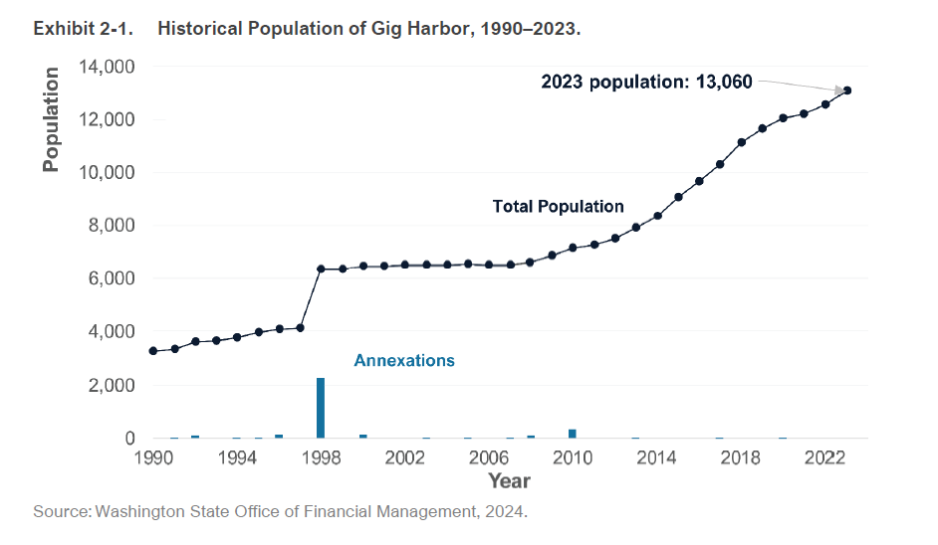
Notes:
This graph shows the previous rate of population growth in Gig Harbor – we are currently a bit above 13,000 and anticipate to be at around 15,600 by the year 2044 – again based on the county projections

Slide 12
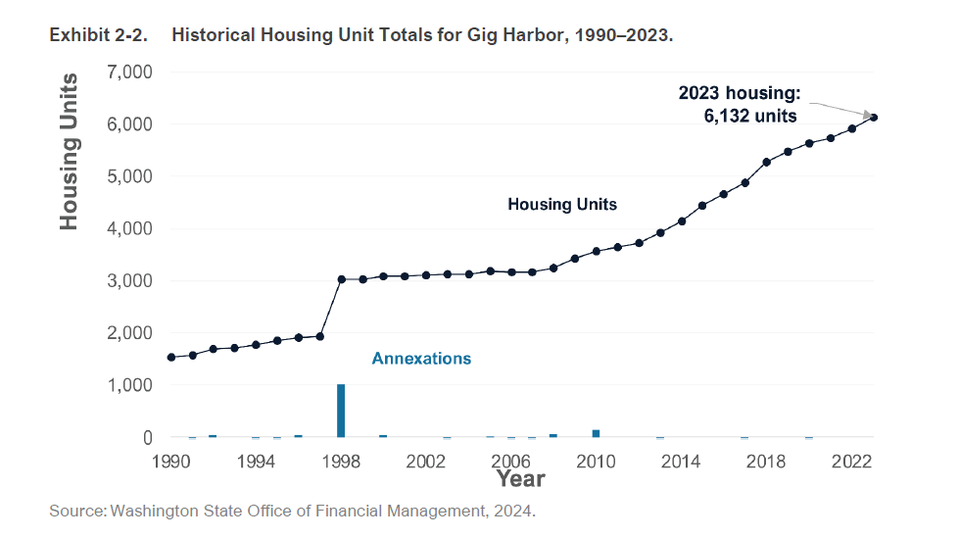
Notes:
Here we see the the path of residential housing construction since 1990 and we are currently at about 6,100 units. By 2044, the county anticipates that we will need an additional 892 units. Because of the HB 1220, the majority of those units will need to meet some level of affordability. Again, our job is to craft policies that accommodate affordability targets over the next 20 years.

Slide 13
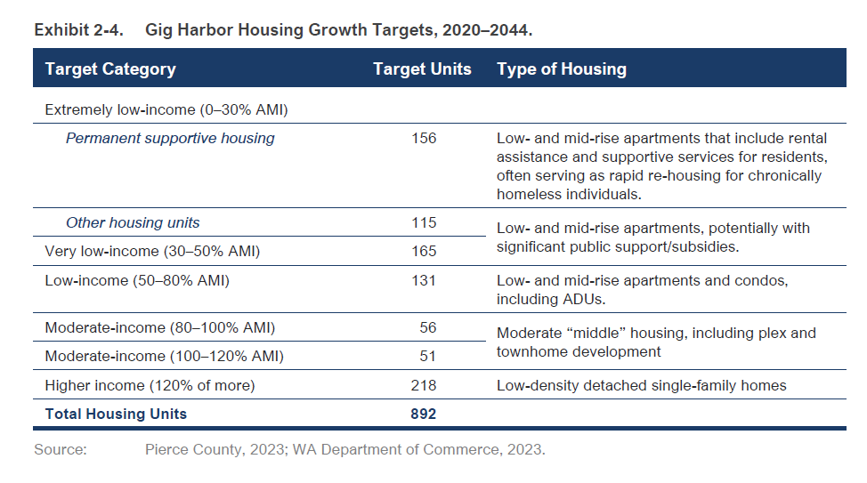
Notes:
Here is the breakdown by income band. AMI stands for area median income and is based on the Tacoma metro area.

Slide 14
Public Outreach Themes
What is our vision for 2044?
The vision: what should Gig Harbor look like in 2044?
Identifying Issues
What are the policy concerns we need to address in our update?.
Consistency
Are our goals and policies consistent with one another?
Scenarios
What policy options/changes do we need to incorporate
Review and Adoption
Notes:
Getting back to the public engagement piece of this project – we have held multiple workshops and staffed booths at more than half of last year’s farmers markets, summer sounds, gig gfest and other events to help get the word out. On December 7th we held a workshop to narrow down the scenarios that define where in the city the new growth should be located

Slide 15
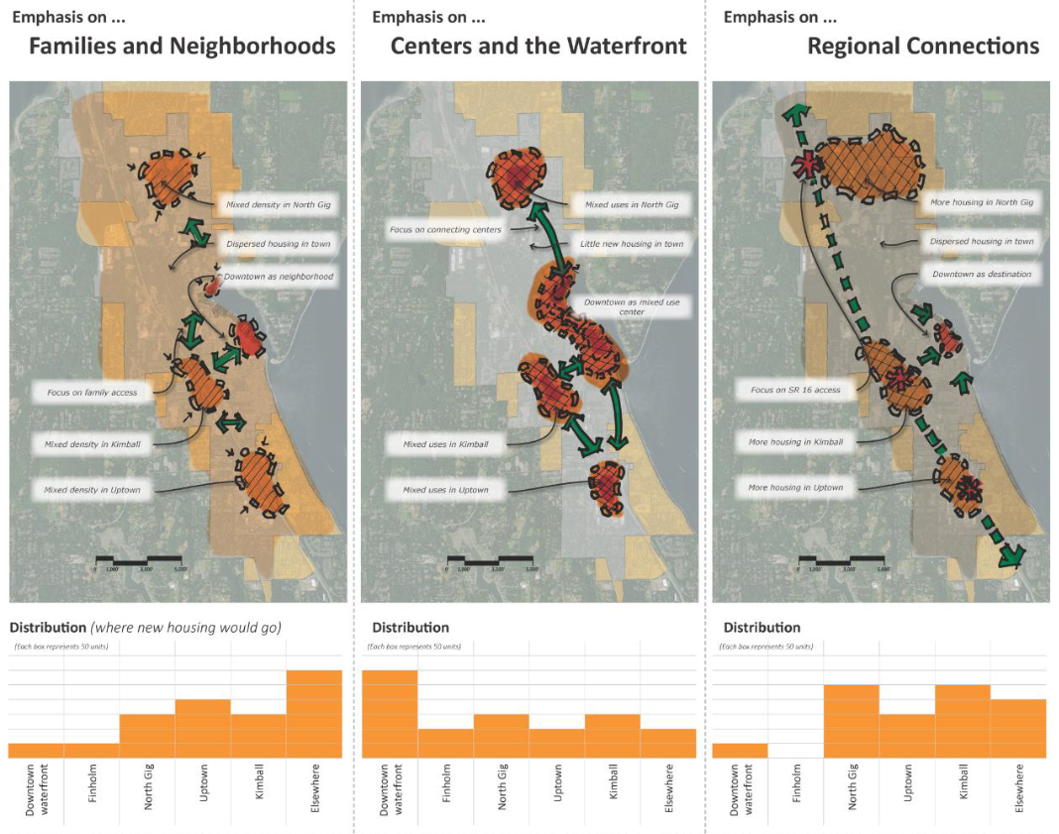
Visioning Exercise December 7, 2023
Notes:
These are the three scenarios that were evaluated at the Dec 7th exercise last year and the clear choice was the middle scenario which focused on the city’s Centers of Local Important (COLIs). The focus of this scenario is really the COLiS. From this, our consultant worked up a draft of our Land Use Element and Map to reflect the potential locations for new growth.

Slide 16
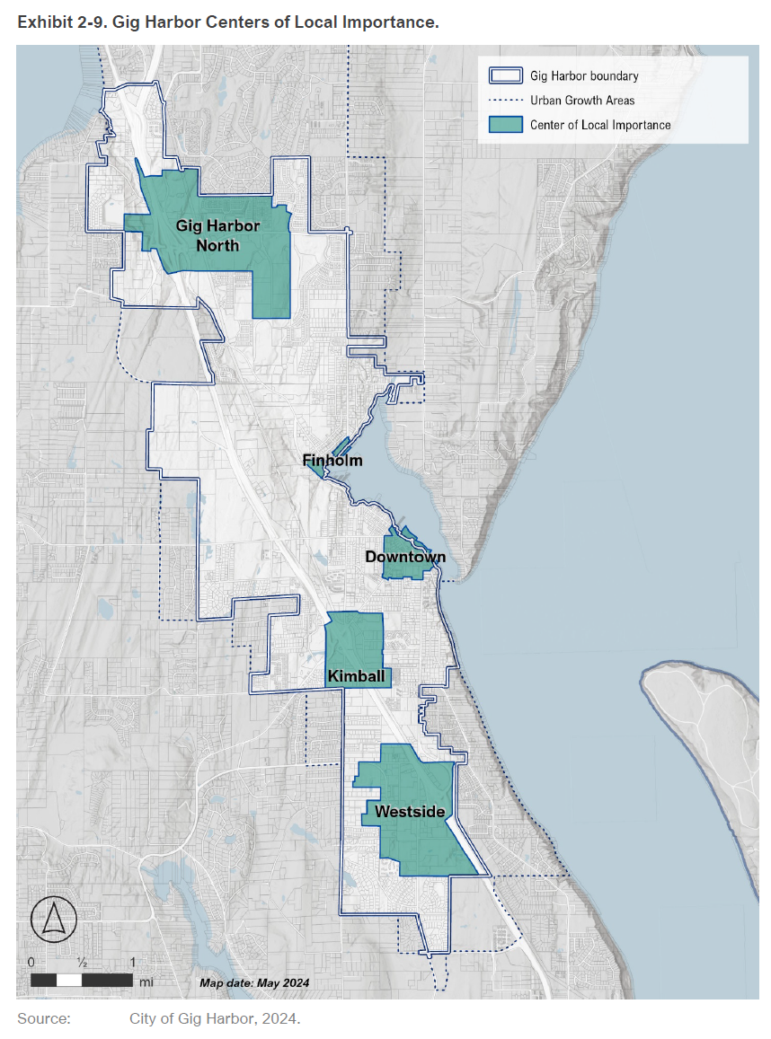
Centers of local importance
Five local centers that can encourage compact, pedestrian-oriented development with a mix of uses that can both support a neighborhood and encourage visitors to come to the neighborhoods to enjoy local amenities
Westside
Gig harbor north
Downtown
Finholm District
Kimball
Notes:
Five COLIs are identified in our existing Comp Plan and these won’t change with the Update.

Slide 17
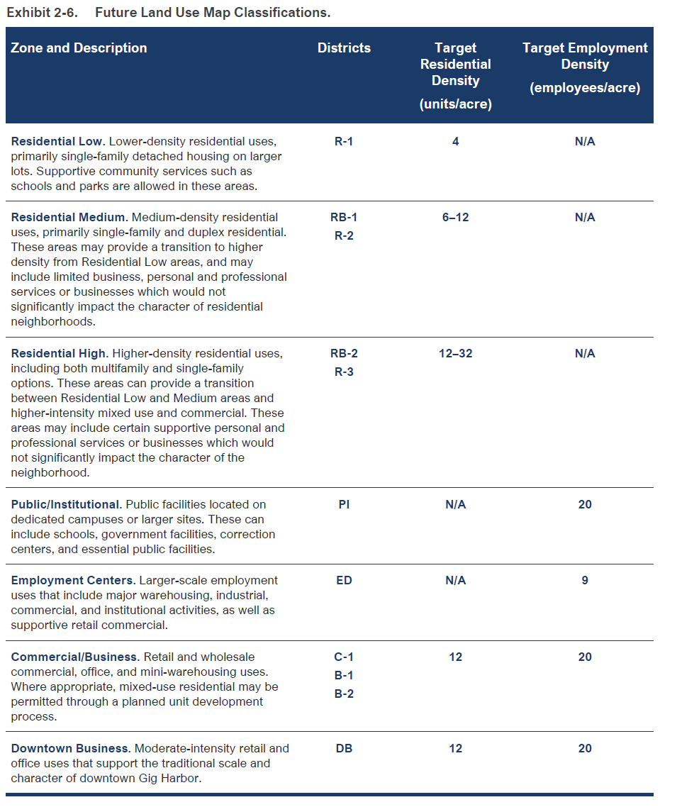
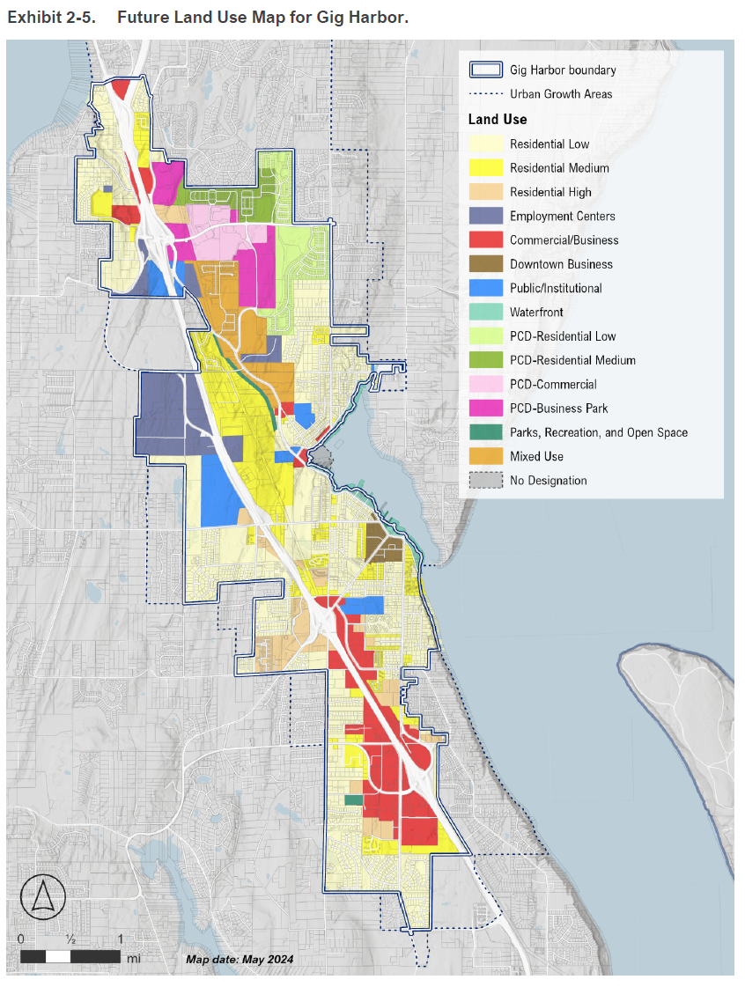
Notes:
Getting into what we anticipate will be one of thekey components of the land use element – you see the proposed future land use map on the right, with target densityies – by landuse designation on the left. The target includes employment, but we will focus primarily on housing tonight.

Slide 18
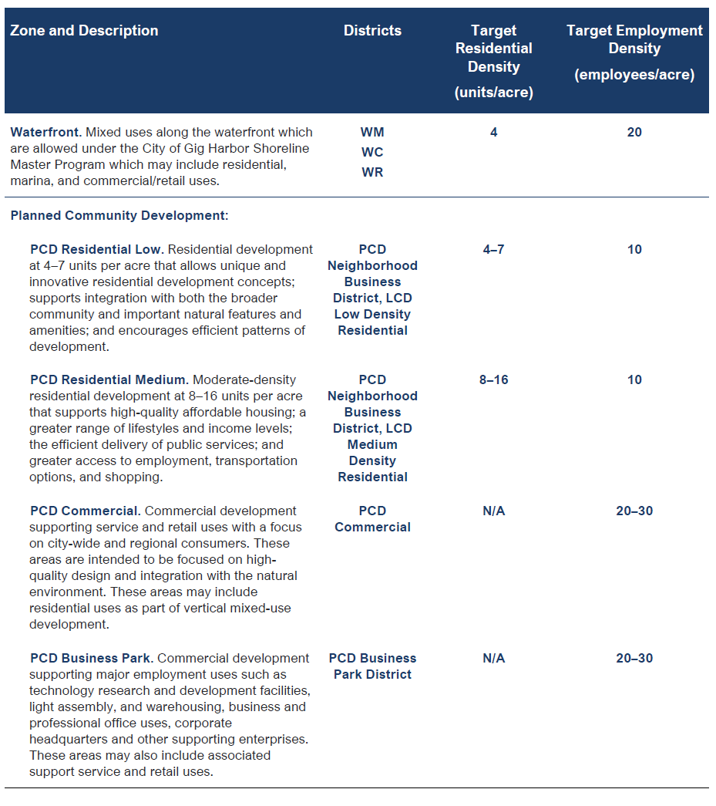

Slide 19
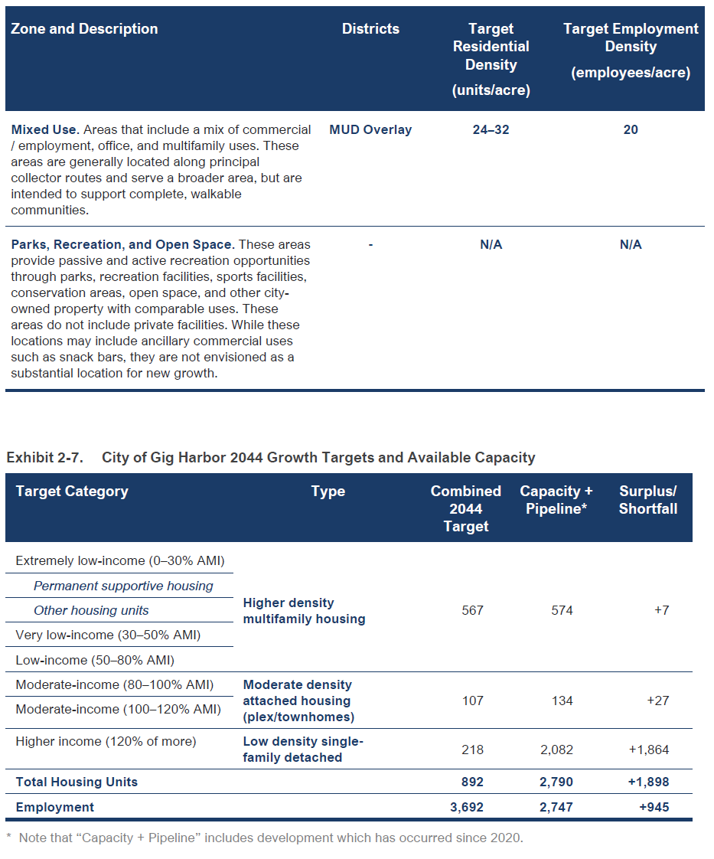

Slide 20
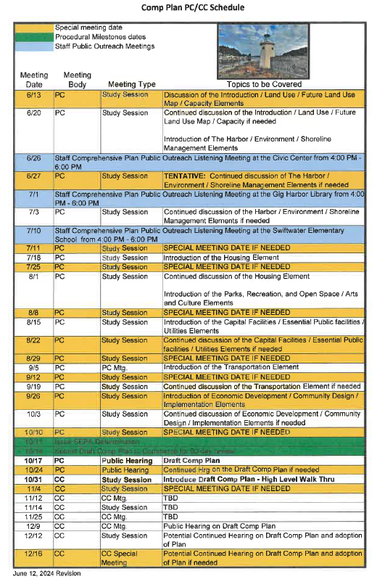
Notes:
Every so often, the timeframe for reviewing comprehensive plan amendmendsd coincides with the timeframe for completing the periodic update. It so happens that this is one of those years.

Slide 21
Questions/Discussion
Robin Bolster-Grant
Rbolster-grant@gigharborwa.gov
253-853-7615

Slide 22
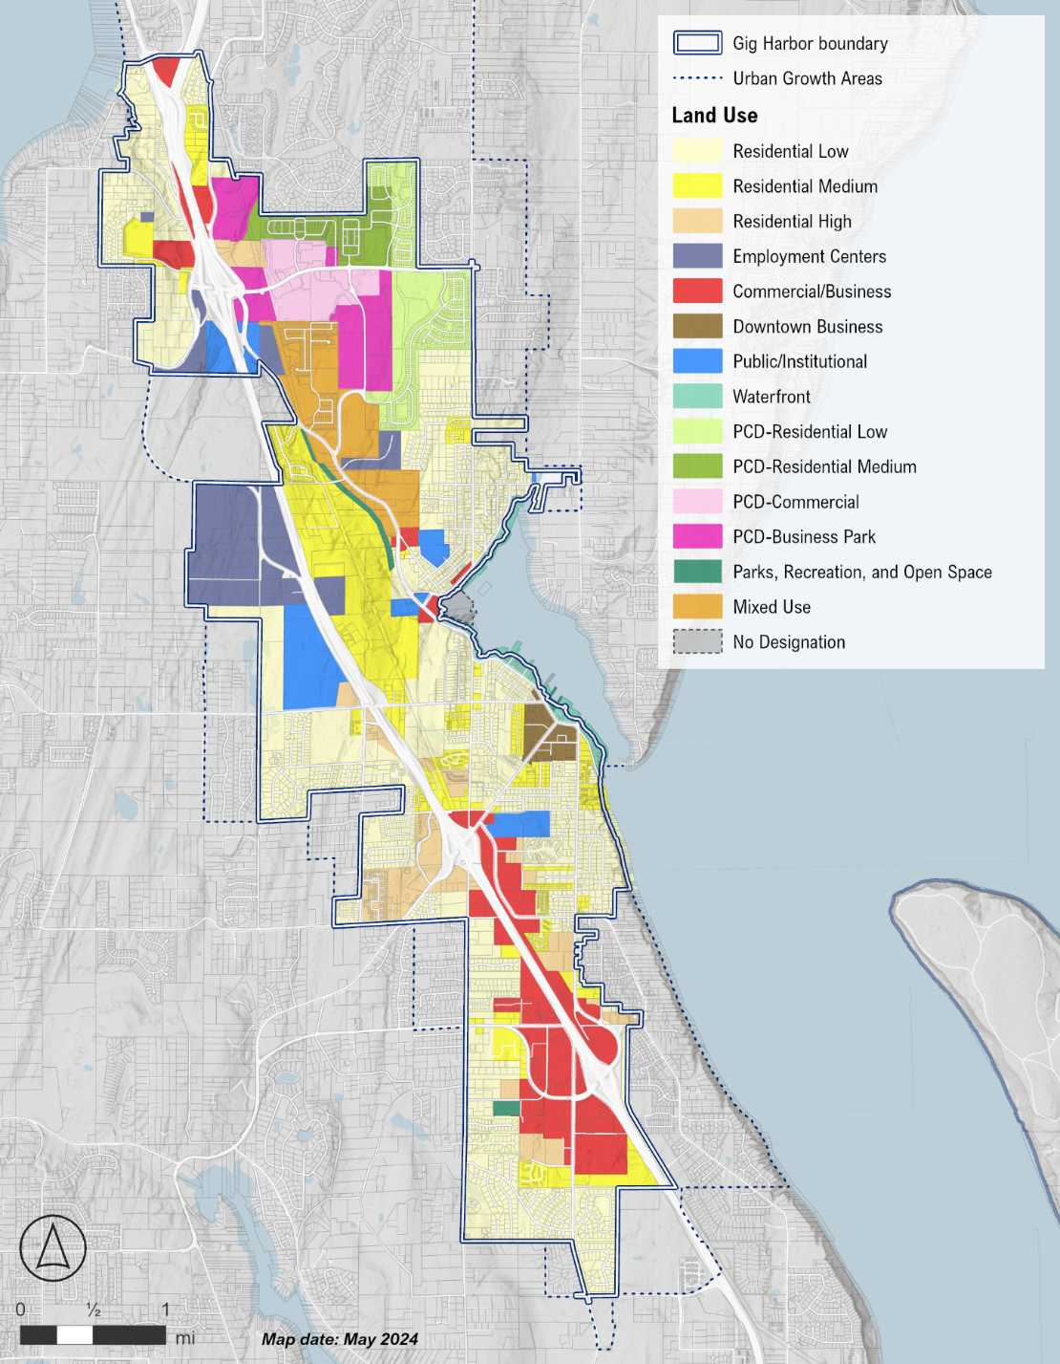
Future Land Use Map
The revised Future Land Use Map proposed in this section maintains most of the features of the existing Land Use Map
Major changes include the following:
Removal of the “Preservation Areas” overlay in favor of development regulations,
Updated “Parks, Recreation, and Open Space” area consisting of City-owned facilities.
Alignment of “Planned Community Development” as a land use with subcategories
Addition of separate “Airport Overlay” and “Height Overlay” districts to consider airport operations at the Tacoma Narrows Airport

Slide 23
Changes in Land Use Assumptions
Increased residential densities in multifamily housing areas to meet lower-income housing requirements:
B-2, DB, R-3, and RB-1 zones have an increase in density to 12 units/acre from the current 4-8 range.
RB-2 zone in Residential/High increased to 32 units/acre from the current 8
Increased the proportion of residential in the residential/commercial split for RB-1 and RB-2 to increase multifamily in these areas
Included nominal estimates of ADU production

