Slide 1
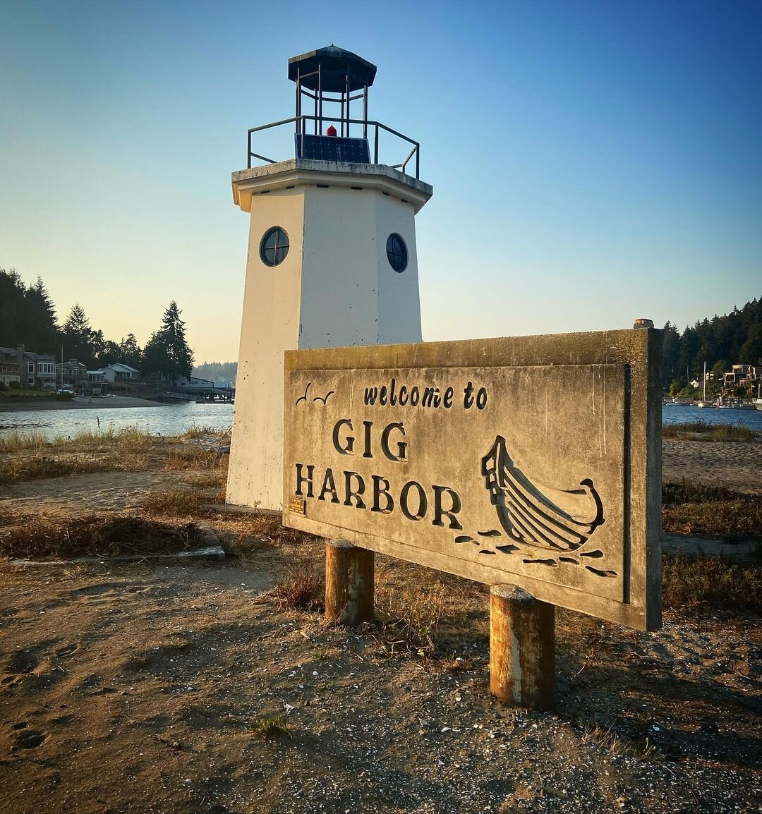
Climate Element
City of Gig Harbor
Open House | February 2025
Notes:
Alyssa – start at 1:33
Hi everyone welcome! We’ll get started here in a couple minutes and just let everyone get settled in.

Slide 2
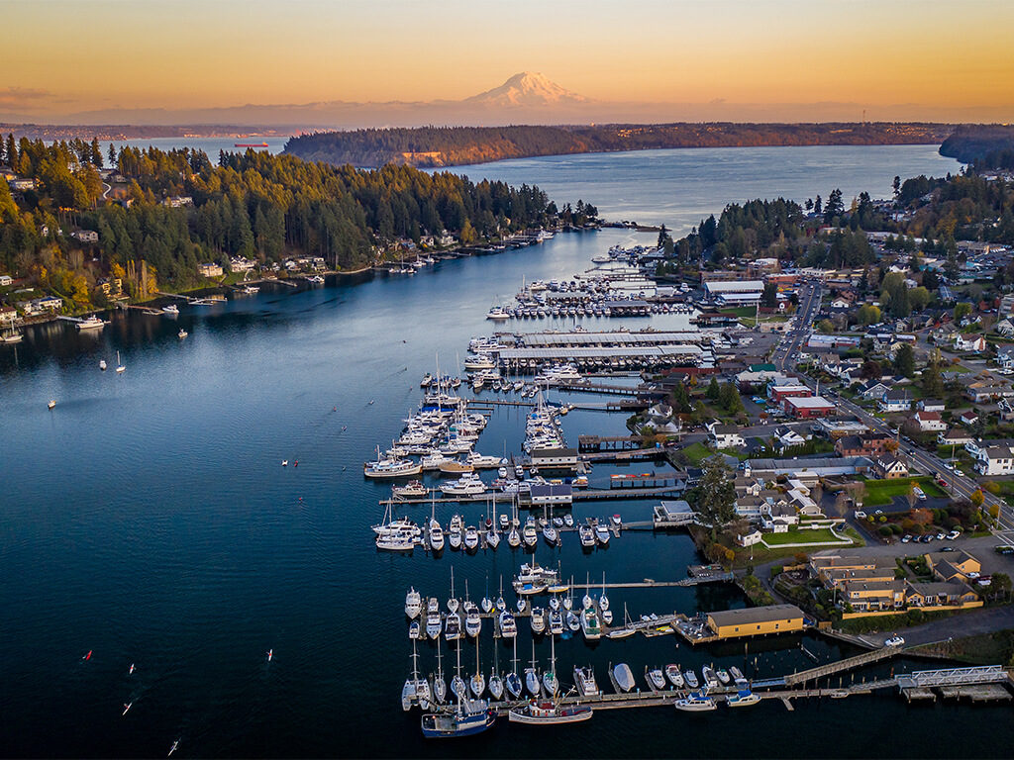
Welcome!
Notes:
Natalie
Welcome
Welcome everyone to the space
Introduce City team present

Slide 3
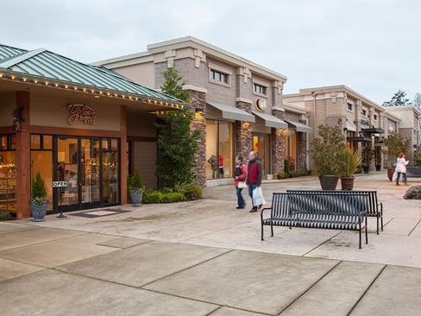
Introduce yourself to your neighbor
Notes:
Alyssa

Slide 4
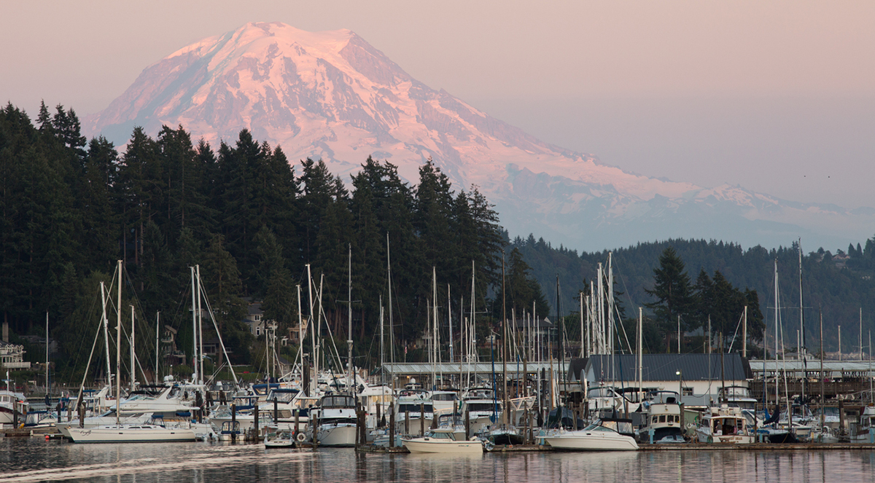
Today’s Agenda
Time | Agenda
10 mins | Welcome & Introductions
15 mins | Presentation
30 min | Discussion activity
15 min | Posters, break for snacks, networking
5 min | Wrap up
Notes:
Alyssa

Slide 5
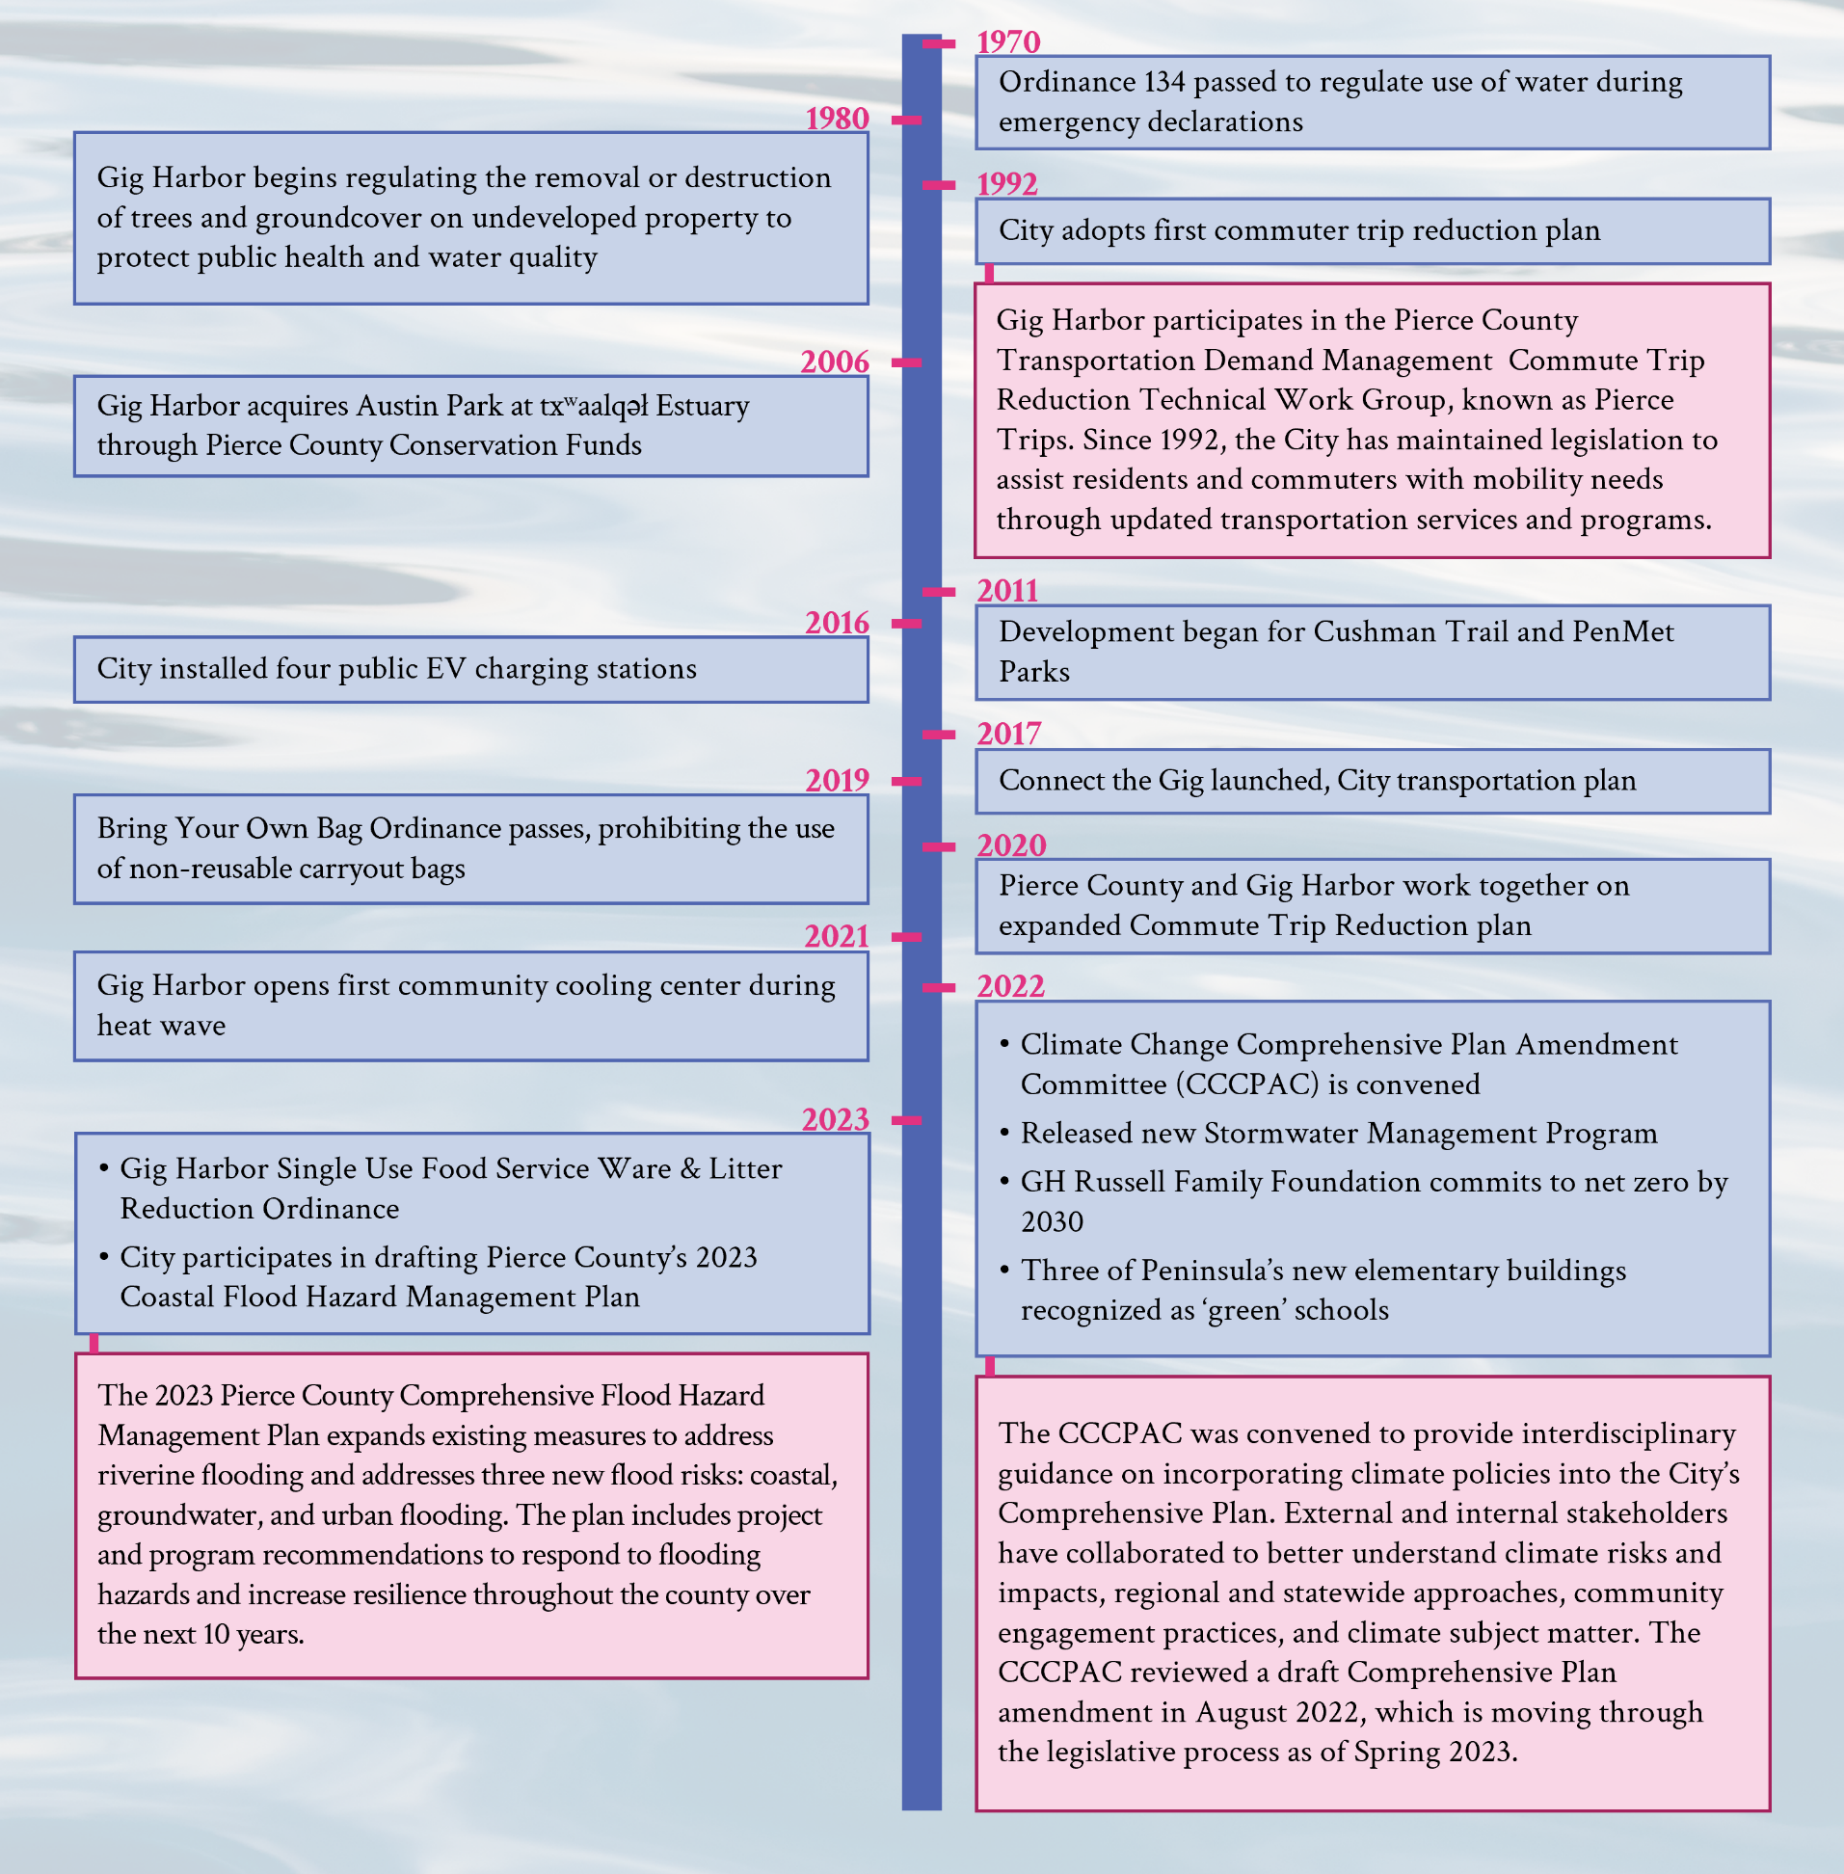
Gig Harbor’s Climate work to date
Notes:
Alyssa
So if you all remember back to 2022, which seems like a long time ago, Cascadia was the firm who developed the Climate Action Plan for the City of Gig Harbor, and I was the project manager for that project. So a few of these graphics have been borrowed from the CAP, but I think they do a good job of illustrating what work has been done to date, knowing that we are missing what happened in the latter half of 2023, like the adoption of the CAP itself.
I won’t read this in detail, but I think it provides a very clear picture of the City’s longstanding commitment to the environment, stewardship, natural spaces and sustainability since the ’70’s. One thing I did want to call out is the Climate Change Comprehensive Plan Amendment Committee (CCCPAC).
The CCCPAC was formed in 2022 and included internal city staff and external partners who were focused on updating the Comp Plan to incorporate climate change goals. The group met biweekly over summer 2022 to talk with climate SMEs and develop climate goals for the City, to ultimately draft a Comprehensive Plan climate amendment (adopted Nov 2022).
We had limited touchpoint with this group during CAP development, however they provided input on CAP implementation plan and our GHG lead met with them in Spring 2023 to talk about emissions targets, and we had also received a ‘wishlist’ of policies from the group to inform action drafting.
So all that to say, that the work of the CCCPAC has given us a really excellent foundation for the Climate Element, which will expand on climate change related policy, focusing on both resilience and emissions reduction.

Slide 6
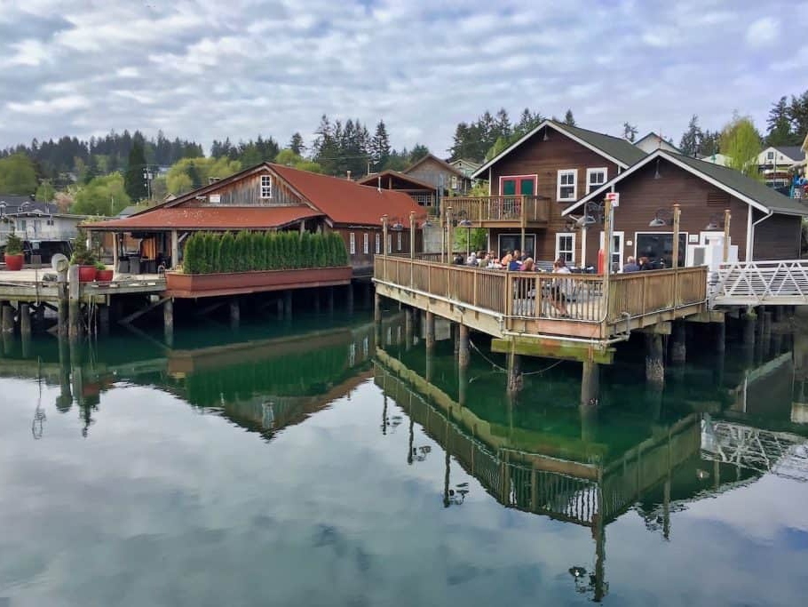
Climate Element
Notes:
Alyssa

Slide 7
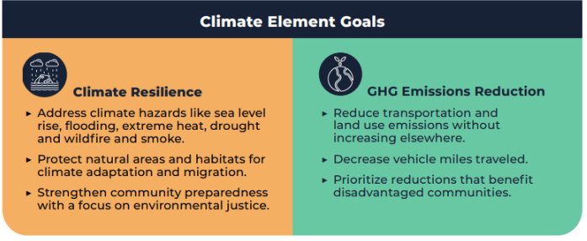
Why are we doing a climate element?
The Climate Element builds on Gig Harbor’s Comprehensive Plan, Climate Action Plan, other City planning and sustainability efforts by increasing resilience to climate impacts and reducing greenhouse gas emissions.

Slide 8
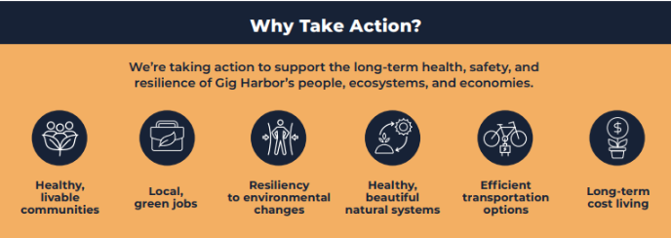
Key Inputs for the Climate Element
Climate Element
Audit of Current City Policies
Community Engagement
Vulnerability Assessment (VA)
Staff Engagement
2019 GHG Emissions Inventory
Policy Development

Slide 9
Community Engagement: Key activities
Survey
Available for Public Comment later this year
Open House
Feedback already heard from the 2025 Comprehensive Plan Update

Slide 10
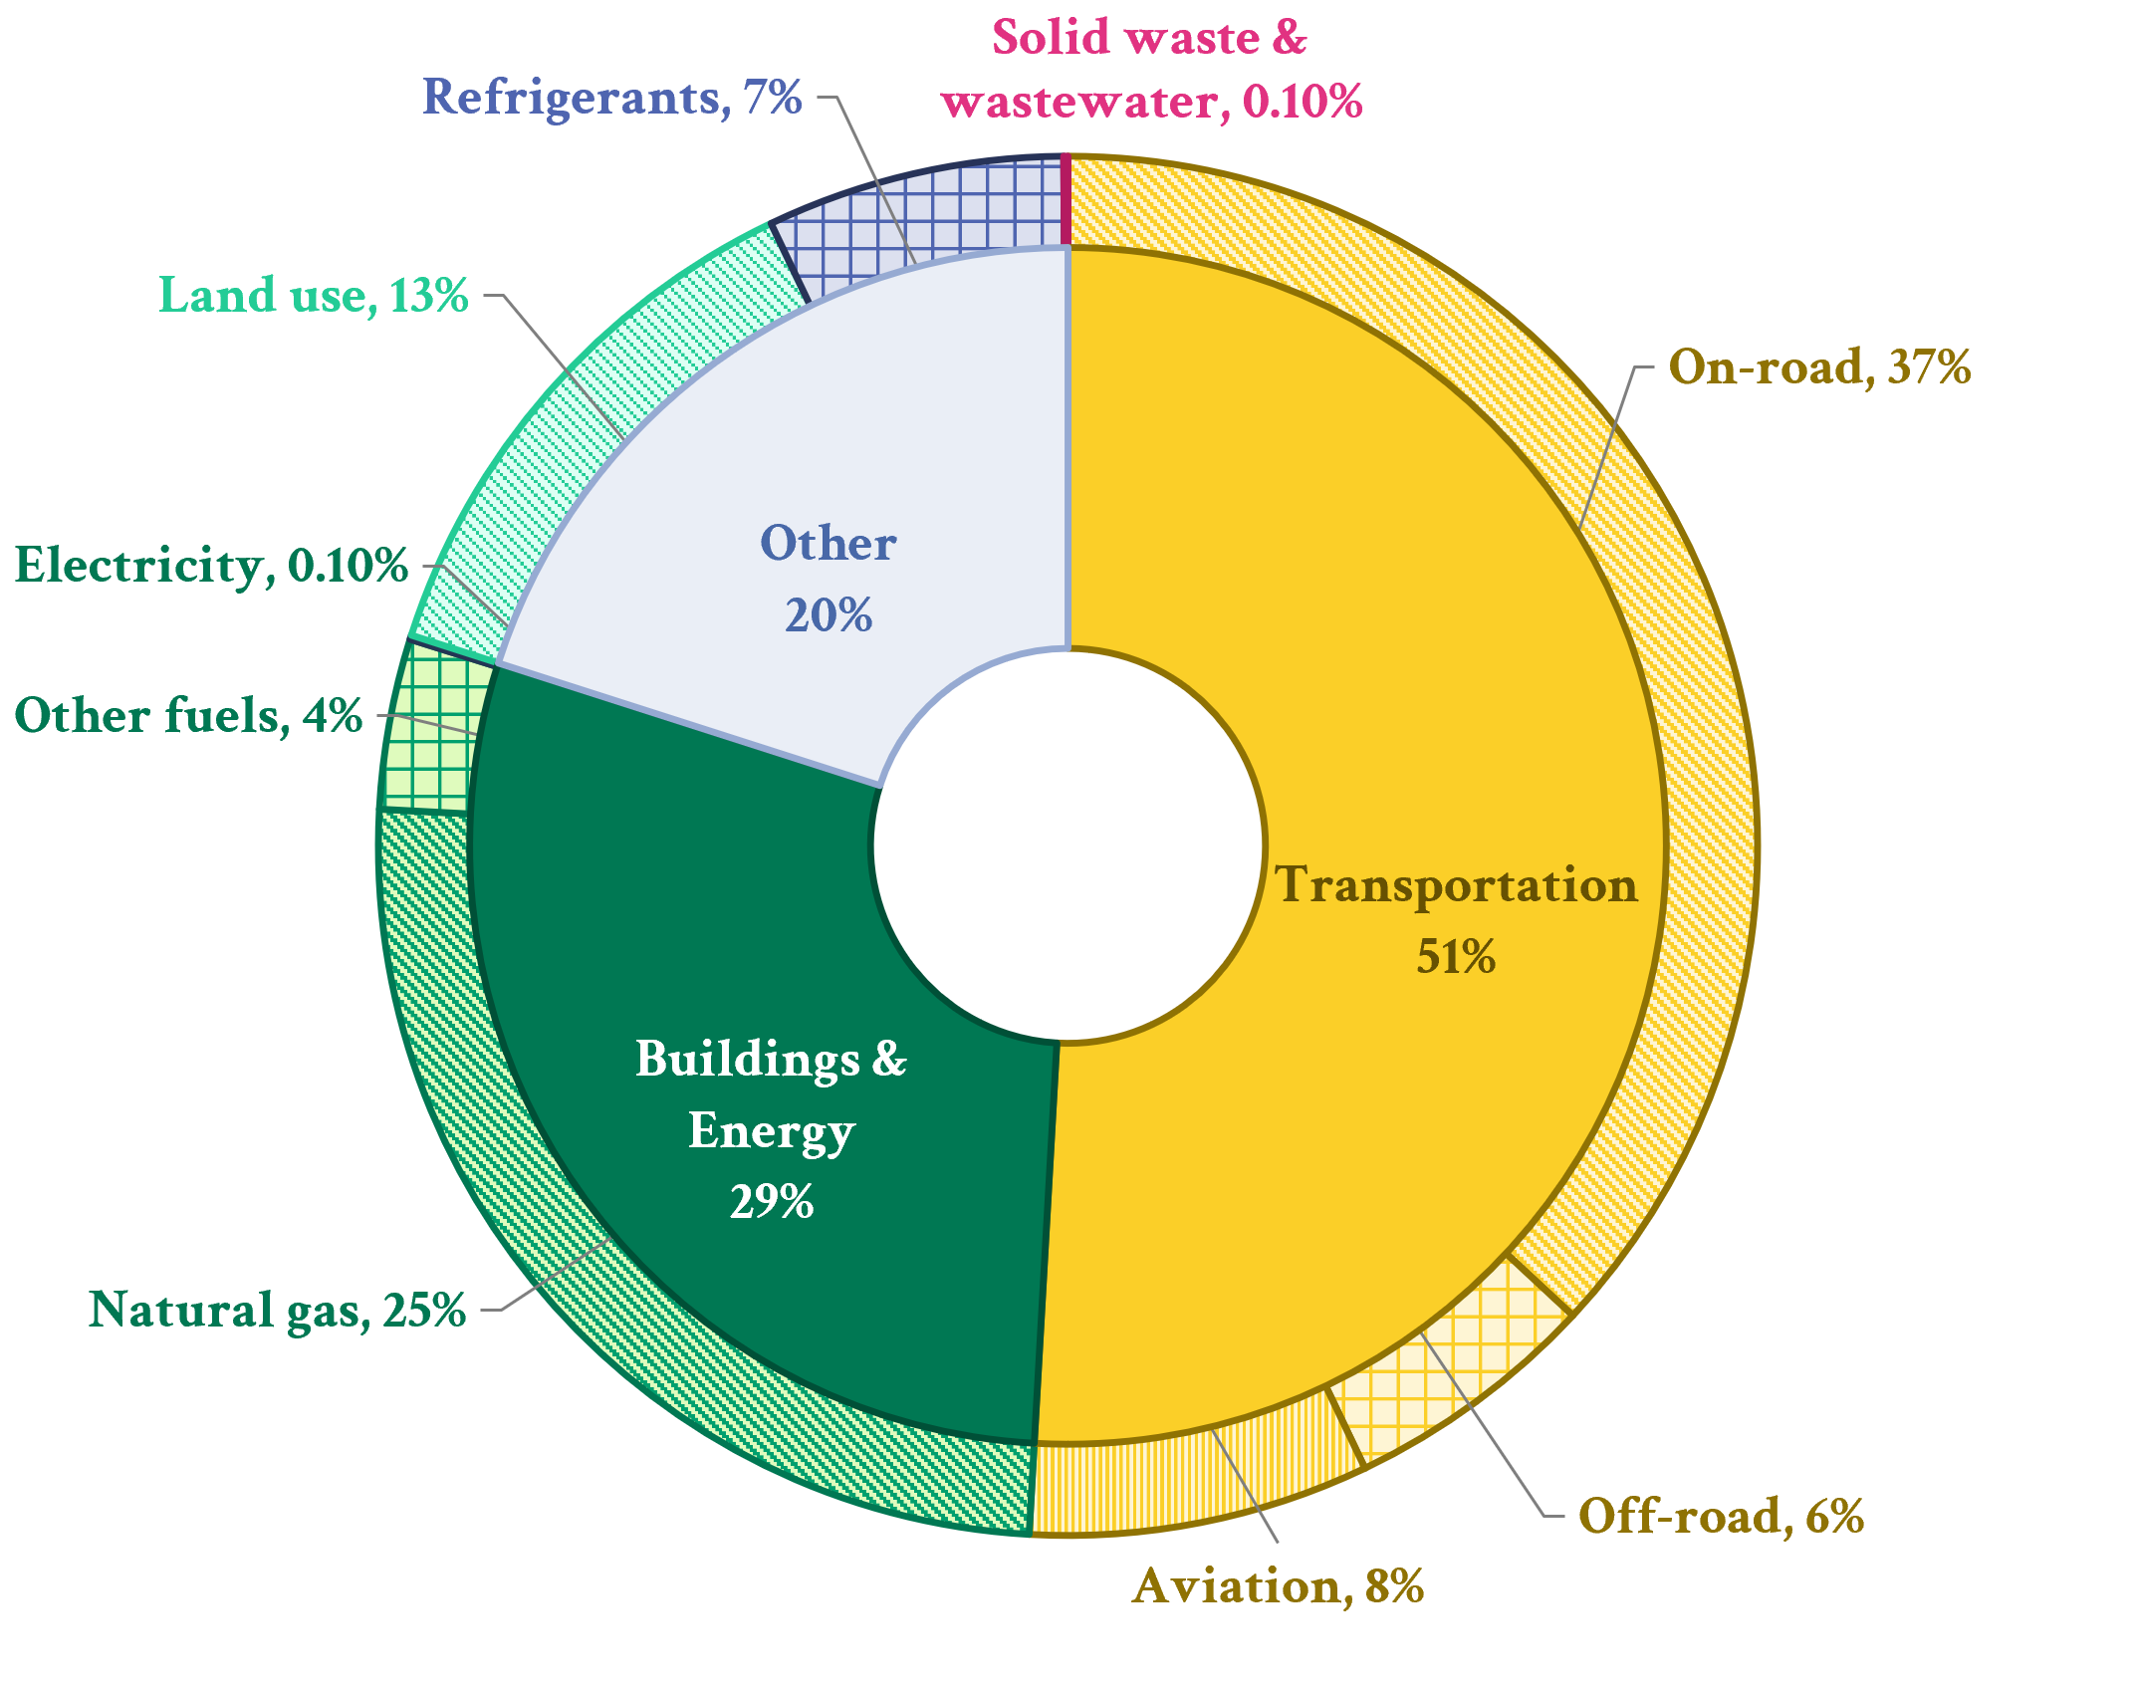
2019 CAP GHG Emissions Inventory
Notes:
We completed a community-wide inventory for the 2019 inventory to inform Climate Action Plan development and will continue to use these results to inform Climate Element development. Transportation and Buildings and Energy were the highest emitters, with a majority of emissions coming from on-road vehicles and natural gas. These are fairly typical inventory results, especially when cities have a clean energy power (PLC = hydropower)
Key takeaways from the inventory/CAP would be to continue focusing emissions reduction policy in the CE around transportation and B&E focus areas
"The top sectors for emissions reduction impact are transportation, building energy, and land use. Based upon Gig Harbor’s emissions profile, Cascadia recommends that Gig Harbor adopt goals and strategies to electrify passenger and service vehicles, reduce vehicle miles traveled, electrify buildings, increase building efficiency, and reduce loss of tree cover.
Aviation emissions were calculated based on SeaTac emissions data and allocated based on GH median income (idea that people with higher incomes travel more)

Slide 11
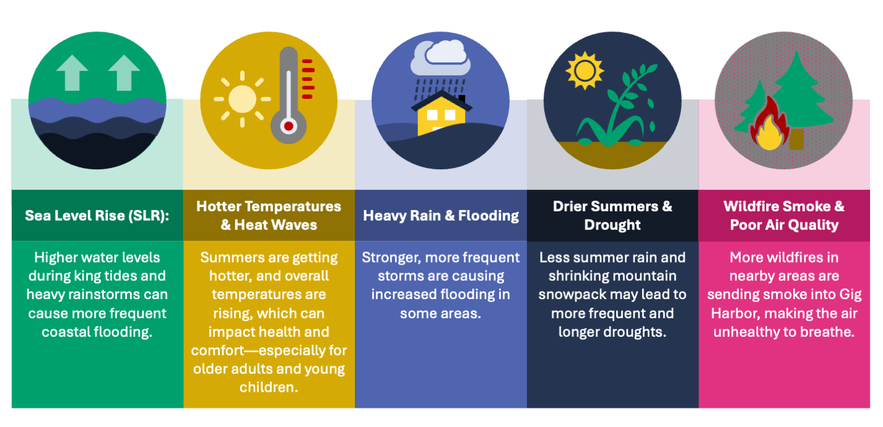
Key Climate Impacts Affecting the City of Gig Harbor
Vulnerability Assessment:
Key Climate Impacts for Gig Harbor

Slide 12
Vulnerability Assessment:
Climate Vulnerability Assessment Overview
Goal: Develop a climate vulnerability assessment for the City of Gig Harbor to inform the CE and future planning.
Review available research & plans
Draft Climate Vulnerability Assessment
Develop Climate Impacts Summary
Final Climate Vulnerability Assessment
Integrate VA findings into CE
Fall 2024 to Spring 2025
Notes:
To ensure that resilience measures address the climate impacts that are most relevant to the City of Gig Harbor, Cascadia will be conducting a climate vulnerability assessment (CVA) as part of the first phase of the Climate Element planning process. The vulnerability assessment will help our team, the City, and planning partners prioritize climate resilience measures. This CVA will comply with Washington State Department of Commerce’s Climate Element Guidance, and can inform the CVA outcomes can inform the Comprehensive Plan Climate Element by:​
Informing us about specific communities and locations that will likely experience climate impacts. ​​
Using future projections to understand impacts, not only historical data.​​
Illustrating holistic and overlapping impacts of climate change on communities, infrastructure, services, and other assets in the city.

Slide 13
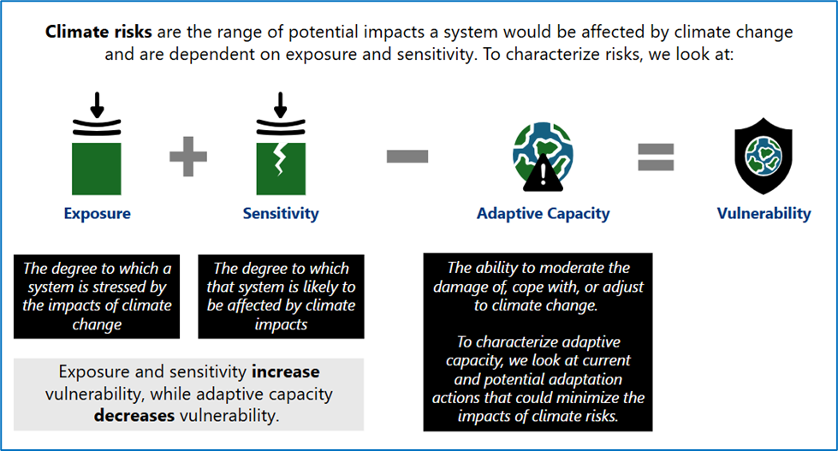
Vulnerability Assessment:
Climate Vulnerability
Notes:
Mike

Slide 14
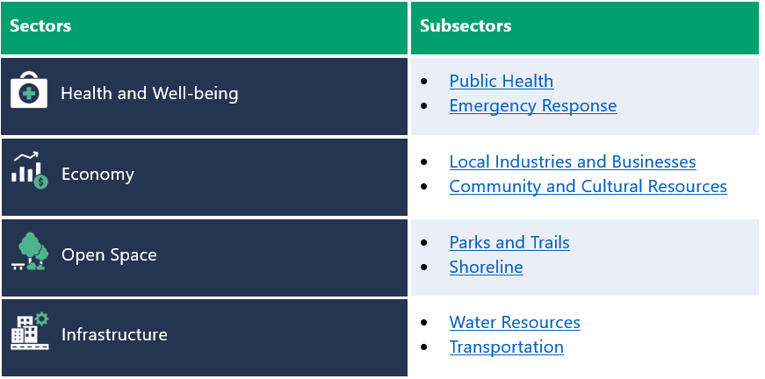
Gig Harbor’s CVA Sectors

Slide 15
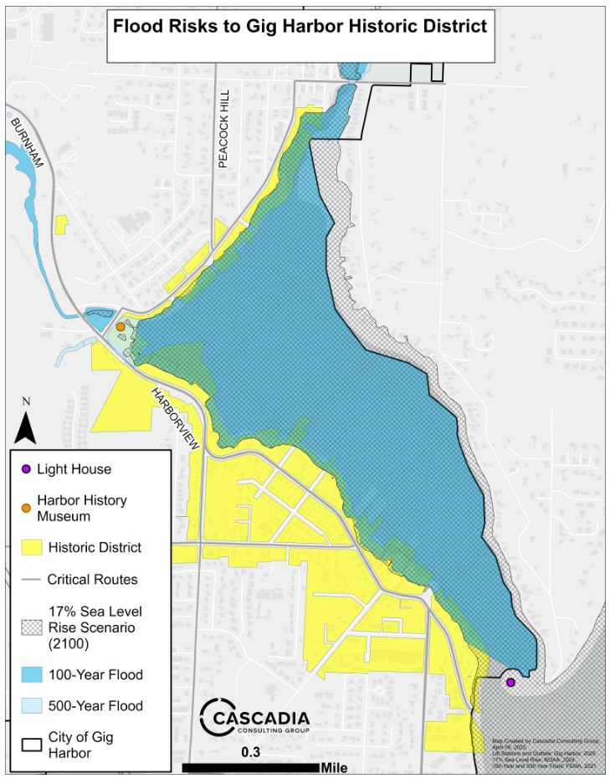
Connecting the CVA to Climate Element Development
Builds on Gig Harbor’s coastal, environmental, and community context
Aligns with the Comprehensive Plan, CAP, and the upcoming Climate Element
Identifies vulnerable sectors, communities, and locations to climate impacts
We’ve brought some maps here today from the VA for discussion!
Data Considerations
Geographic relevance to Gig Harbor
Current and localized climate science
Trusted, peer-reviewed sources
Uses future projections, not just historical trends
Notes:
One key finding from the VA is that the Historic District and Downtown are vulnerable to climate impacts such as sea level rise and flooding.
Maps in the VA:
Heat and transportation
SLR/flooding and transportation
SLR/flooding and shorelines
SLR/flooding and sewer infrastructure
Cultural resources and historic district and SLR
Critical facilities
Heat and elderly populations + retirement community/assisted living locations
Cardiovascular disease
Wells, aquifers, and flooding
Stormwater and flooding

Slide 16
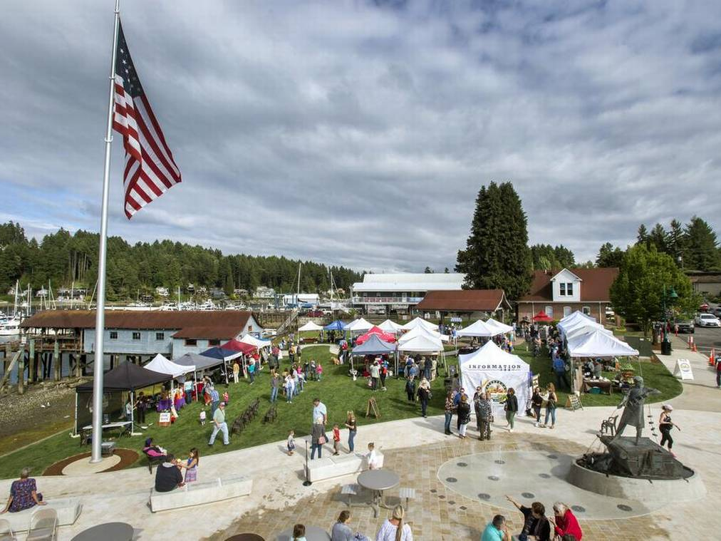
Discussion
Notes:
Alyssa

Slide 17


What climate impact are you most concerned about? Have you, your family, or your community been affected by extreme weather events?
What specific actions would help the Gig Harbor community build resilience to extreme weather and climate change impacts?

Slide 18
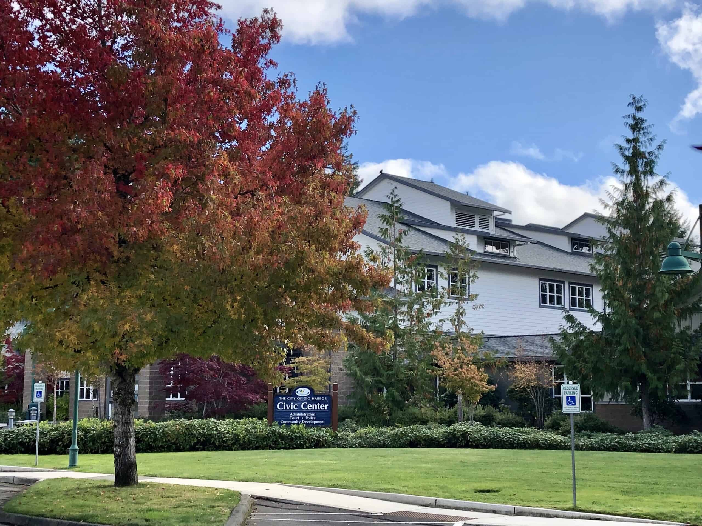
Posters, Snacks, Networking
Notes:
Alyssa

