Slide 1
Building, Implementing, and Strategizing for MFTE programs
Considering MFTE
Katherine Mitchell
MFTE Program Manager
January 27, 2025
Notes:
Introduce self, welcome, slides will be emailed,
Please interrupt

Slide 2
What is MFTE?
The Multifamily Housing Property Tax Exemption (MFTE) program is designed to help communities meet their housing goals under the Growth Management Act.
  Provides a property tax exemption in exchange for rehabilitating or constructing housing units.
  Available for 8-, 12-, and 20-year periods, each with different minimum requirements for housing affordability.
  Communities have broad flexibility to customize these programs.
  While this program is simple to describe, there are a lot of complexities to how it can be used!
Notes:
In the most basic terms, MFTE is tax relief in exchange for housing production.
• The Multifamily Housing Tax Exemption is a framework, codified in RCW 84.14, that allows cities and counties to provide a property tax exemption in exchange for providing at least 4 new housing units through projects that build or rehabilitate housing.
• An MFTE program can provide exemptions between eight and 20 years, with different levels and timelines for affordability.
• In addition to the minimum requirements in the statute, cities and counties can further customize their MFTE program to meet their established housing goals and policies. This flexibility can be useful for providing greater levels of affordability, or providing other public benefits.
• While this explanation can seems pretty straightforward, there are still a lot of complexities in both the state framework and local programs that are important to understand. Which is why we are offering this opportunity to dig into MFTE.

Slide 3
Who has adopted MFTE?
Pierce County | Issaquah | Renton
Auburn | Kenmore | SeaTac
Bainbridge Island | Kent | Seattle
Battle Ground | Kirkland | Shoreline
Bellevue | Lacey | Snohomish
Bellingham | Lake Forest Park | Snoqualmie
Blaine | Lake Stevens | Spokane
Bothell | Lakewood | Sumner
Bremerton | Lynnwood | Tacoma
Burien | Marysville | Tukwila
Camas | Moses Lake | Tumwater
College Place | Mountlake Terrace | University Place
Covington | Newcastle | Vancouver
Edmonds | North Bend | Walla Walla
Ellensburg | Olympia | Washougal
Enumclaw | Othello | Wenatchee
Everett | Port Angeles | Woodinville
Federal Way | Port Townsend | Yakima
Ferndale | Puyallup
Fife | Redmond
Between 2007 and 2023:
58 jurisdictions adopted an MFTE program – 57 cities and 1 county
479 projects have been completed using the exemption
Over 61,000 new housing units were completed using the exemption program
Of those units, over 11,000 were rent- and income-restricted affordable units
Since 2021, all cities are eligible to adopt MFTE. 2024 program data is still pending.
Notes:
Across the state, 58 cities and one county have adopted an MFTE program. We’ve seen wide adoption in communities of all sizes and character, because MFTE can be customized to meet each local government’s needs.
Fife and Battle Ground are the newest adoptees of the MFTE program. 61,000 new units have been completed with the program since 2007, 11,000 of them affordable.

Slide 4
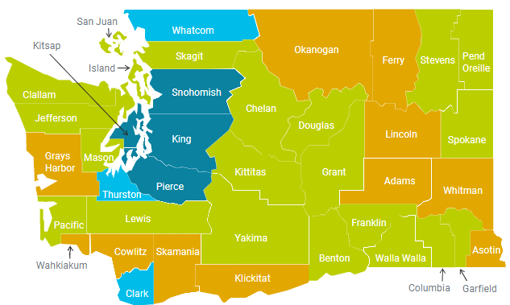
Why invest resources in MFTE?
Meet goals under the Growth Management Act
Direct growth to urban centers
Incentivize middle housing types
Develop public private partnerships
Incentivize transit-oriented development
Protect farm and resource lands
Notes:
• MFTE programs that have been created across the state in jurisdictions of all sizes to support housing.
• In 2023, 67 MFTE projects received certificates across 17 cities in 8 counties. That’s 727 affordable units and almost 6,000 total. You can find the full details of our annual reports at Commerce’s MFTE home page.

Slide 5
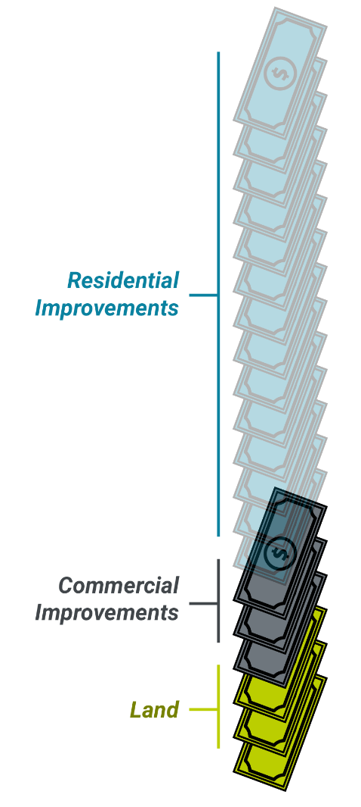
Tax Exemption
Under local MFTE programs (cities and counties), all property taxes on residential improvements are exempted
  This includes taxes that that go to the state, school district, special districts, etc.
  Non-residential improvements are not included
  (e.g., ground-floor commercial in mixed-use buildings).
  For rehab projects, only new improvement value is exempted.
Notes:
Statue defines the exemption granted by the program as: “The value of new housing construction, conversion, and rehabilitation improvements qualifying under this chapter is exempt from ad valorem property taxation”
• So the basis of an MFTE program is that cities and counties are authorized to exempt property taxes on the residential improvement value of new projects.
• This is not just local taxes, but all property taxes. This includes the shares of property taxes that go to the state and other taxing districts as well.
• However, only new residential improvements are included in this exemption. Non-residential improvements, such as ground-floor retail in mixed-use projects, are not be exempted. The value of the land is also not exempted.
This means that while property taxes are significantly reduced, they are not completely waived for these projects.
• Also note that this involves new improvement value, not existing value on a property. For rehabilitation projects, this means that only part of the residential value will be exempt from taxation.

Slide 6
MFTE projects bring local revenue
MFTE does not result in a reduction of revenue for the jurisdiction. A tax shift occurs, where the value of exemptions are paid by other property owners
New MFTE residential development also results in increases in other local revenue:
  Sales taxes from construction
  Real estate excise taxes (REETs)
  Impact fees, connection charges, and other fees
  Non-exempt property taxes
  Increases in state-shared revenue
  Increases in local sales and business and occupation (B&O) taxes from resident spending
Notes:
MFTE does not result in a reduction of revenue for the jurisdiction. A tax shift occurs, where property is assesed at new construction values and then removed from the rolls and the value of exemptions are paid by other property owners. We’ll discuss tax shift in greater detail later on.
It’s important to note that MFTE programs typically have a positive impact on the local tax base in the long term. The City of Tacoma has told Commerce that they have come out positive on every exemption issued under the MFTE program. This is because projects increase revenue in many ways:
Taxable construction activities related to projects supported by MFTE will remit sales taxes to state, city and county governments.
Upon sale, rental and owner-occupied MFTE units will pay excise taxes to state and local governments. This will cover not only initial sales upon the completion of construction, if applicable, but also future sales.
While not "tax revenue" per se, MFTE projects will also be responsible for impact fees, connection charges, and other development fees charged by a community. For projects that include affordable housing, local governments may have programs that provide partial or even full waivers of these charges as an additional incentive.
While the residential improvements on a site will be exempt, commercial components of buildings and underlying increases in property value will still be taxable. For mixed-use buildings or revitalization projects, this would represent an increase beyond a vacant site or a site with heavily depreciated improvements.
In addition to impacts related to the building itself, there are also local effects from sales taxes paid by the residents of new construction, and additional B&O taxes from new local businesses. Note that while both can be related to an increase in local business activity, higher sales taxes can also be received from online purchases charged at local points of sale.
Certain sources of state funding support for local jurisdictions may depend on local population (or in the case of school funding, local student enrollment). In these situations, an MFTE program that supports an increase in local population may adjust the results of these calculations.

Slide 7
Tax Exemptions
Variable length of exemption, with different base requirements for each:
  8 years (no minimum affordability requirements).
  12 years (affordability requirements).
  20 years (affordability requirements with additional provisions).
12-year extensions are also optionally available for 8- and 12-year MFTE.
MFTE can apply to both rental and owner-occupied housing.
Notes:
• This exemption is not permanent and will expire after a certain length of time. The different periods—eight, 12, and 20 years—all have different minimum affordability requirements under the statute, and some will have additional requirements about the types of projects that are eligible.
• There are 12-year extensions allowed for the eight- and 12-year programs, which are typically applied with similar requirements to local 12-year programs.
• Note as well that this applies to both rental housing as well as owner-occupied housing. As such, this can be a way of promoting affordable homeownership within the community too.
• Also, while this presentation will focus on the requirements as presented in the statute, jurisdictions can add more restrictive requirements to these three programs than what is required by the state.

Slide 8
Residential Targeted Areas
Communities designate the areas where MFTE can apply as “Residential Targeted Areas” (RTAs).
These areas have certain requirements (RCW 84.14.040):
  Must be within an “urban center” as determined by Council, which means that “urban residents may obtain a variety of products and services” in that center.
  Must lack “sufficient available, desirable, and convenient residential housing, including affordable housing”.
  Additional housing in this area will help meet local goals.
  Additional requirements for counties (e.g., anti-displacement).
Notes:
• Under the state requirements, communities must identify those areas where MFTE can be applied, and designate these areas as “Residential Targeted Areas”, or RTAs, through a resolution.
• These areas are required to have certain characteristics. First, they must be within an “urban center” as determined by Council, which means that urban residents may obtain a variety of amenities, including recreation space, and access to retail and services.
• They must also lack sufficient available, desirable, and convenient residential housing, including affordable housing. Essentially, this means that there needs to be enough of a gap between local supply and demand to keep people out of the neighborhood that might want to move into the area.
• New housing built in the area would also help to meet local goals, both in terms of just meeting the overall amount of housing needed and potentially meeting the needs for specific types of housing, including affordable housing options.
• Finally, there are some additional requirements for counties included. The most significant of these requirements is that a study of potential housing displacement is necessary before an RTA is designated. This is good practice and cities should look to do these kinds of studies as well, but the statute specifically requires this only for counties.
• Note that different communities designate RTAs in different ways under this framework:
All multifamily residential areas (Seattle, Spokane).
All neighborhood centers (Tacoma).
Transit station areas / TOD (Renton).
Areas targeted for redevelopment (Vancouver).
Individual sites (Issaquah).
• It’s also important to note that communities may decide to apply different program parameters to different RTAs, such as different length of exemptions or different requirements for application. This means that communities can tailor their program to meet different needs in different neighborhoods: one area that needs significant investment where development may be less feasible could receive incentives with fewer requirements for public benefits, for example.

Slide 9
Minimum Requirements for MFTE
Eight-year exemptions have no additional requirements under RCW 84.14.020.
Under the statute, 12-year exemptions require the following:
  At least 20% of the units must be affordable to households earning up to low- and moderate-income households, at 80–115% of Area Median Income (AMI).
  At the end of the exemption, the occupants of affordable units must be granted one month’s rent for relocation assistance.
12-year extensions have similar requirements, but only allow rentals to households up to 80% AMI.
20-year extensions include long-term affordability requirements and have more complex prerequisites for cities.
Notes:
• As noted before, there are different minimum requirements based on the length of the exemption under this framework. These requirements are focused on housing affordability, although there may also be some requirements for the type of project included.
• First, eight-year exemptions have no additional requirements from the state. This means that a 100% market-rate project can be exempted from property taxes under the program. Typically, these types of programs are most applicable in cases where affordability is not the primary concern, such as cases where communities just need additional housing development or are looking to redevelop specific areas such as older commercial districts.
• The 12-year exemption requires that projects provided at least 20% of the units as affordable units to households earning up to low- and moderate-income households. This means that only households making up to 80–115% of the Area Median Income in a particular location would be eligible for this income-restricted housing.
• For these income-restricted units, the occupants of affordable units must be granted one month’s rent for relocation assistance at the end of the exemption, when the rent on their unit can be increased to market rents.
• The 12-year extension has similar requirements to the 12-year base exemption, but it only allows rentals to low-income households up to 80% AMI, even if operating as an extension to an eight-year MFTE.
- The 20-year exemption has more complicated requirements, and we won’t go into them at this time.

Slide 10
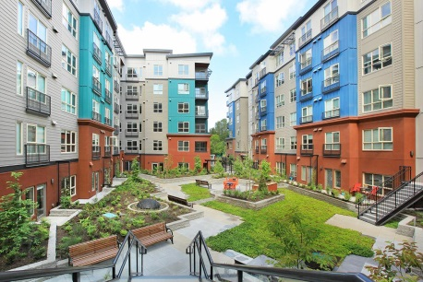
Additional Requirements for MFTE
Communities can also provide their own requirements:
  Additional affordability requirements (including 8-year requirements).
  Project benefits such as:
    LEED certification.
    Public amenities.
  Contractual provisions such as:
    Prevailing wage.
    Apprenticeship utilization.
    Contracting inclusion plan.
Notes:
• What we have been covering is with minimum state requirements, however. Under the statute, however, communities have the latitude to provide for their own requirements to help meet their own needs.
• The most common change that many communities make is to tighten the affordability requirements. This can involve increasing the number of affordable units included in a qualifying project, but most often this is focused on reducing the maximum household incomes for qualifying households.
• However, other communities have used the MFTE to mandate that projects must provide other public benefits to qualify. This can include such things as LEED green building certification, or contributions to public amenities such as parks. These public benefits need to be commensurate with the development incentives provided from the program, however, and this will be layered on top of the affordability requirements that would already be included.
• Additionally, communities can provide contractual provisions for project operations, with requirements for prevailing wages for workers, inclusion planning, and use of apprenticeship programs as part of the development agreement that implements the MFTE program.

Slide 11
Considerations for Communities
Is MFTE a good fit for your goals?
Notes:
Given these characteristics, would MFTE be a good fit for your community? And if it is, what are the characteristics of a local program that would be the most important?

Slide 12
Considering objectives for MFTE
MFTE projects must be properly calibrated to have the desired effect. MFTE is useful when:
  A community is looking to increase housing production.
  Certain areas are being considered for focused redevelopment and incentives are needed to promote new investment.
  Housing affordability is a major concern, and the community needs an incentive to encourage development of income-restricted units.
Developers will consider MFTE when it provides a pathway to make new construction pencil.
Notes:
To meet housing needs shown earlier, many communities have seen the need to accelerate housing production even in changing economic situations. Providing an incentive such as this can help to facilitate new projects, especially in communities where development would need additional support to be feasible.
MFTE can target a specific area or neighborhood for reinvestment/redevelopment, and incentives are needed to catalyze new investment.
Housing affordability can be addressed via MFTE, and the provisions for housing affordability can help to increase the availability of units for low and moderate income households. This isn't a full solution, especially since it can be challenging to address the needs of very low- and extremely low-income households through this program alone. However, this can be one effective tool in a housing toolbox.
Whatever the reason for consideration – jurisdictions should remember that developers will only participate in MFTE program when it makes financial sense for them to do so. You can not consider MFTE from a jurisdiction ONLY perspective.

Slide 13
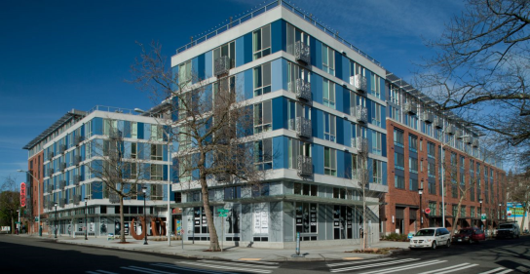
Initial Review
What are the overall housing needs in the community?
What other housing policies and programs are offered?
Can MFTE help promote desired development?
Notes:
• When the need for an MFTE program is being explored, it can be important to explore several different factors:
• What are the overall housing needs in the community?
• What are local housing goals and targets?
• How do development trends compare with projected housing targets?
• Are there specific areas that require more investment?
• Are there shortfalls in specific types of housing?
• Are there shortfalls in affordable housing production against targets?
• What other housing policies and programs are offered?
• Have they achieved their goals or progressing towards those goals?
• Are they aligned with identified needs?
• Can MFTE help promote desired development?
• Would an MFTE program cover the housing types and areas in need?
• Would it make financial sense for developers to use the program, now and/or in the future?
• Can MFTE work with other housing programs/incentives?
• Can MFTE serve as a catalyst for other development?

Slide 14
Considering Impacts and Implementation
Financial impacts:
  Tax shifting.
  Potential reduced revenue for other taxing districts.
  Costs/fees associated with the program.
Community engagement:
  Council / Planning Commission / staff.
  County assessor.
  Developers.
  Affordable housing organizations.
  Residents.
Housing displacement risk:
  Potential application to areas with
  naturally-occurring affordable housing.
  Increase in development pressures / prices.
  Options for affordable housing requirements.
Resources:
  Available staff capacity.
  Integration into permitting process.
  Materials for publicizing the program.
Notes:
• Aside from the housing needs in a community, there are also other considerations to keep in mind. Many of these elements could be presentations unto themselves! Because of that, we won't get into them in great detail, but there are resources available from the Department of Commerce's MFTE webpage that can provide more information about these considerations.
• With financial impacts, one critical consideration is that the money for the tax exemption comes from somewhere. Depending on different factors, this could be through reduced tax revenues or tax increases, either of which have implications that need to be discussed. Additionally, there are costs for administration and ongoing reporting and oversight that would need to be considered by communities as well.
• Community engagement is a critical component of the success of an MFTE program. Even aside from the public hearing required to designate an RTA, communities should be active in hearing both sides of the program. Developers will be able to tell you whether the program will work under current financial conditions, and other stakeholders, including Council, Planning Commission, and the general public, will be important to engage to understand if the public benefits are worth the incentives provided.
• Housing displacement is an important consideration, especially since when used improperly an MFTE program can increase development pressures and accelerate displacement. Understanding local conditions and options for incorporating requirements into an MFTE program that can address displacement can be critical to mitigating the impacts on existing communities.
• Finally, MFTE programs need to be administered by local staff. First and foremost, this needs staff resources. However, understanding how to publicize and integrate the MFTE program into existing processes will be essential.

Slide 15
Administering the Program
What should you expect with an MFTE program?
Notes:
And that transitions well into this next section: how do you actually create and administer an MFTE program?

Slide 16
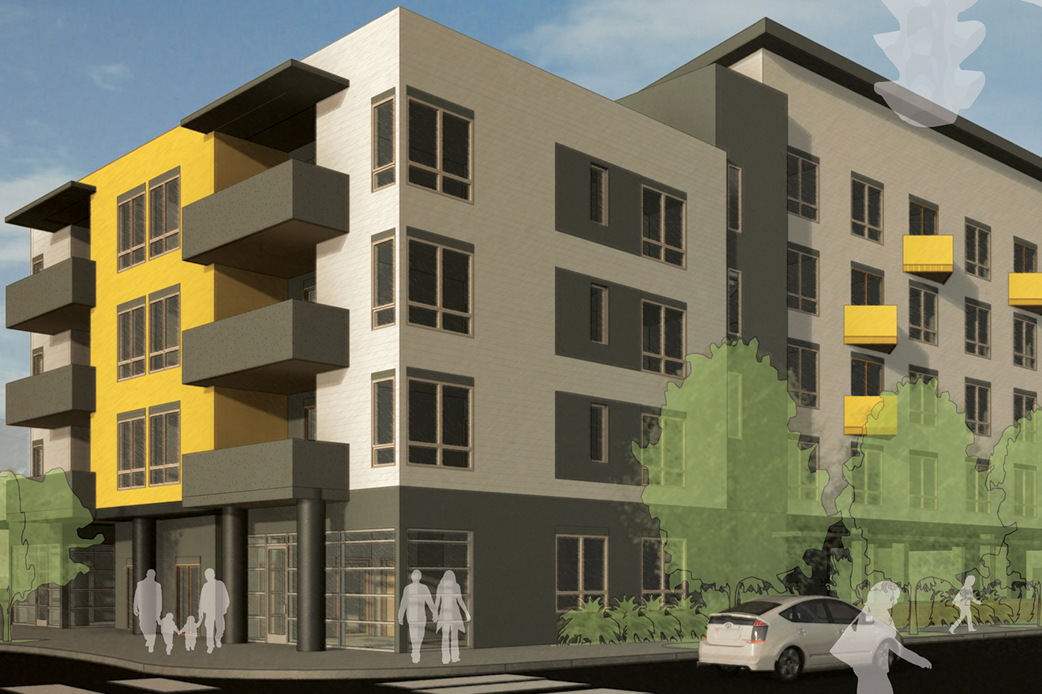
Overall Management
There are several steps in establishing and running an MFTE program in a community:
  Adopting the program
  (and revising over time).
  Managing applications.
  Issuing exemptions.
  Coordinating ongoing monitoring, outreach and reporting activities.
Notes:
When we're looking at the life cycle of an MFTE program, once a community decides it wants to establish an MFTE program, there are typically several steps they follow.
• First, adopting or revising the program requires coordination to set up the major elements of the program.
• Under the program, you will need to shepherd applications from initial receipt to approval.
• Once approved, the exemption needs to be issued and managed by the County Assessor.
• Finally, even after the exemption is issued, communities still have required steps with regular monitoring, outreach and reporting.

Slide 17
Adopting the Program
Designate MFTE staff and resources.
  Generally, smaller jurisdictions simply have MFTE as one of the duties of existing staff, and don’t need additional hiring to adopt MFTE.
Evaluate where the MFTE program will apply and adopt these as Residential Targeted Areas.
Define exemption lengths/types based on:
  What your jurisdiction can offer under the statute.
  What types of exemptions will help meet local housing needs.
Draft and adopt an ordinance customized for your jurisdiction.
Develop materials for the public.
Notes:
• When adopting the program, there are several steps that communities need to take.
• A critical step which can be easy to overlook is that staff and resources should be specifically allocated to the program. In many cases, communities provide for a fee to collect to partially or completely offset this staff time, but this needs to be explored up front to ensure that the community can support the necessary overhead.
• The community should evaluate where the MFTE program would apply based on its goals, and adopt these locations as Residential Targeted Areas. This does require a public process to complete.
• After designating the RTAs, a community should define the parameters of the program. Most significantly, this would include the exemption lengths/types. This can be affected by what your jurisdiction can offer under the statute, as well as how these options would fit with addressing local housing needs.
• The MFTE program needs to be developed as part of an ordinance, which should be drafted to consider these different factors. Commerce has supporting material that is useful at this step, including model code, sample forms and certificates, and other materials.
• Finally, communities need to develop public materials, both for developers and for general information. This can help both to publicize the program to encourage its use, and to answer questions that may come up from residents about how the program works and what it is intended to do.

Slide 18
Wrapping Up
In this presentation, we have covered:
  An overall summary of MFTE and its important components.
  Factors to consider when creating/updating an MFTE program.
  How to implement and administer an MFTE program.
Notes:
• In this presentation, we’ve covered several topics, including an overall summary of MFTE and its important components, factors to consider when creating and updating an MFTE program, and how to implement and administer an MFTE program.

Slide 19
Final Thoughts
The MFTE framework is a substantial incentive, both for market-rate and affordable housing.
The real-estate and housing market still play a major role in the development of housing.
Other policy solutions can work well with MFTE, such as removal of barriers to various housing types with 4+ units and other housing incentive programs.
The potential to customize the program is great, but the incentives need to match expectations of developers.
Notes:
• A few final things to keep in mind.
• The MFTE framework can be a big incentive in the private market for market-rate and affordable housing. This means that it can help to achieve a lot of housing goals more effectively than other incentives.
• However, remember that the market still plays a major role in the development of housing under an MFTE program. If market conditions change, that can affect the efficacy of an MFTE program in meeting local housing goals.
• But this also means that when used in conjunction with other housing incentives and programs targeted to the private market, you can get better results. Any exploration of MFTE should also consider the other programs that are currently available or could be implemented, like inclusionary zoning.
• Also just make sure to match the incentives with what developers can provide for those incentives when considering customized requirements. It can be important to ensure that it makes financial sense for property owners to participate, instead of simply walking away or choosing to move forward without the tax exemption. Very deep levels of affordability for instance can be attractive from a policy perspective, but tax exemptions can be hard pressed to compensate owners for the reduced rent revenue.

Slide 20
Final Thoughts
The MFTE does have costs that need to be balanced what communities will receive from the incentive.
The purpose and goals of the program may change over time.
This program should be revisited regularly to maximize public benefit.
Notes:
And that brings forward the overall point that for the MFTE to work, it has costs that need to be balanced with what is received from the program. This is true of developers that may choose to participate based on whether they will come out ahead financially even if they need to provide affordable housing. However, it is also applicable for the public as well! The private incentives provided through the tax exemption need to be balanced by the public benefits received through increased housing production, affordable housing opportunities, neighborhood revitalization, and other elements.
Because the need for these public benefits will change over time, however, the purpose and the goals of the MFTE program will also change. Communities may have created an MFTE program initially to promote redevelopment of their downtown and increases in local housing development, but over time development conditions may have improved and there is a greater need to improve access to affordable housing. In situations like this, there may be a decision to change the parameters of the MFTE program to shift incentives to favor affordable housing.
Overall, communities need to revisit their programs pretty regularly to ensure that both the public benefits and the private benefits are worth the costs, and very importantly, that the public is clear about what is being received in exchange for the costs of the program.

Slide 21
Available Resources
Department of Commerce MFTE program:
  Website.
  Staff technical support.
MFTE Workbook:
  A detailed, step-by-step explanation of the program.
  Model code to use when implementing a local MFTE program.
  Sample forms and certificates that can be used to administer MFTEs.
Local resources: other administrators, developers, etc.
Notes:
• There are more details to the MFTE framework that are important to consider that we have only touched on in this webinar, and there may be other questions that you may have. So where can you find more information?
• First, the Department of Commerce currently provides support for the MFTE program. There is a website run by Growth Management Services that provides more details on the program, and there is staff technical support available that can help answer any questions you may have.
• The Department of Commerce has also put out an MFTE workbook that includes most information about the program overall, as well as model code and sample forms and certificates. This can also be a source for answers that you may have about MFTE.
• However, there are also informational resources from the broader community. Other municipal administrators of MFTE programs are often quite willing to talk about their own experiences and challenges, for one. It can also be important to engage with local developers, who can be a resource on what may be possible to do with the incentives provided by an MFTE program.

Slide 22
Questions?
Katherine Mitchell
MFTE Program manager
Katherine.Mitchell@commerce.wa.gov

