Slide 1


City of Gig Harbor
Affordable Housing Townhall
WHY ARE WE HERE?

Slide 2
Townhall Objective:
To provide community members with a foundational understanding of affordable housing, state requirements, and the Multifamily Tax Exemption (MFTE) program. We aim to facilitate an informed space for dialogue, with opportunities for attendees to engage directly with housing experts and local partners.

Slide 3
Townhall Agenda
5:30–5:45 p.m.: Why Are We Here? Presentation by Shea Smiley; Housing Health and Human Services Program Manager
5:45–6:00 p.m.: How We Got Here? Presentation by WA State Department of Commerce
6:00–6:45 p.m.: Q&A Panel
6:45–7:30 p.m.: Breakout Sessions: Attendees can choose between sessions:
Multifamily Tax Exemption (MFTE) Program
Affordable Housing Basics

Slide 4

According to the U.S. Department of Housing and Urban Development (HUD), what percentage of income should be spent on housing (rent or mortgage) and utilities to be considered affordable?
30%
A
35%
B
50%
C

Slide 5
According to the U.S. Department of Housing and Urban Development (HUD), what percentage of income should be spent on housing (rent or mortgage) and utilities to be considered affordable?
30%
A

Slide 6
True or False:
There are several “types” of housing that meet the definition of affordable.
TRUE
FALSE

Slide 7
True or False:
There are several “types” of housing that meet the definition of affordable.
TRUE

Slide 8

The Housing Spectrum
Emergency Shelter
Transitional Housing
Permanent Supportive Housing
Public Housing
Project Based Rental Assistance
Housing Choice Vouchers
Workforce Housing
Market Rate Rental Housing
Home Ownership

Slide 9
What does AMI stand for?
Area Most Income
A
Area Median Income
B
Around Median Income
C

Slide 10
What does AMI stand for?
Area Median Income
B

Slide 11
What is AMI for City of Gig Harbor?
$85,000
A
$98,125
B
$106,042
C

Slide 12
What is AMI for City of Gig Harbor?
$106,042
C

Slide 13
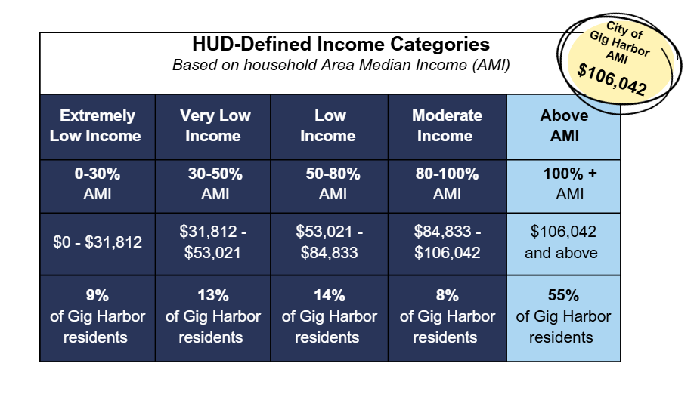

Slide 14
True or False:
Gig Harbor does have a need for
affordable housing.
TRUE
FALSE

Slide 15
True or False:
Gig Harbor does have a need for
affordable housing.
TRUE

Slide 16
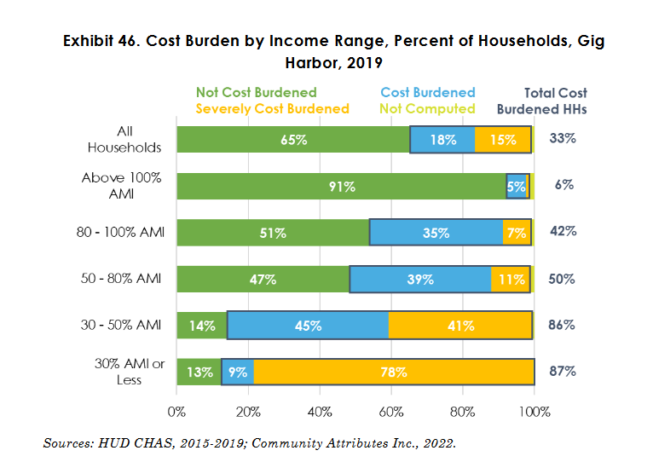
Cost-Burdened: A household spending more than 30% of its income on housing.
Severely Cost Burdened: Households that spend more than 50% of their gross income on housing costs

Slide 17
What age demographic makes up the majority of low income, very-low income, and extremely low income individuals in our community?
18-24
A
62+
B
34-39
C

Slide 18
What age demographic makes up the majority of low income, very-low income, and extremely low income individuals in our community?
62+
B

Slide 19
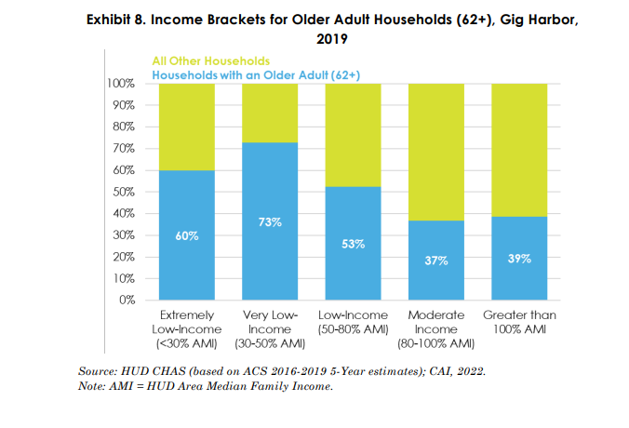

Slide 20
Now that we have talked a little about WHY we are here today, let’s hear from WA State Commerce on HOW we got here from a state legislative perspective?

