Slide 1
Policy choices for affordable housing
Optional and
Notes:
Not required, but want to select some to show adequate provisions

Slide 2
Factors for affordable housing
Who lives in affordable housing?
Where should it be located?
What types of housing can be affordable?
What types of zoning is necessary?
What incentives can a community offer?
Where does the money/ support come from?
Who builds affordable housing?
How do we assure continued affordability?

Slide 3


Washingtonians Want More Housing Options
In the Department of Commerce’s statewide 2022 Housing Survey, we learned that more than 3/4 of Washingtonians want more housing options for all people in their communities.
Many communities across Washington have a variety of different housing types, from single family homes, to duplexes, to backyard cottages. A mix of types of housing in a neighborhood creates more inclusive and thriving communities.
Notes:
Puget Sound Regional Council & Washington State Department of Commerce December 2022 Housing Survey (psrc.org)

Slide 4
Our Diverse Needs Require Diverse Housing
Demographics for housing in our state have changed. About 28% of households today are one-person households.
By 2030, the U.S. Census Bureau predicts about one in five Americans will be 65 years of age or older.
These trends are partly behind our state’s need for a greater number of smaller-sized units.
of housing in Washington State today is zoned as single-family homes.
70%
Notes:
Washington’s demographics are changing. Smaller household sizes are partly behind our state’s need for a greater number of smaller-sized units.
Washington State Department of Commerce, Projected Housing Needs March 2023 (commerce.wa.gov)
U.S. Census Bureau Quick Facts (census.gov)

Slide 5

Adding to our housing supply ensures people like seniors, teachers, firefighters, childcare workers, and healthcare workers can afford to stay in their communities throughout their lives.
Notes:
Speaker notes:
83% of Washingtonians say more reasonably priced housing is needed in their communities to meet diverse needs.
Sources:
Puget Sound Regional Council & Washington State Department of Commerce December 2022 Housing Survey (psrc.org)

Slide 6
Location matters: Where should lower cost housing be located?
Near public transportation to reduce transportation cost
Near public amenities such as parks, open space, trails
Near services – grocery stores, schools
Not near freeways, or other environmental hazards
Zoning needs sufficient density to “pencil”. 3-4 story “walk ups” most cost effective.

Slide 7
Who builds affordable housing?
Private developers (apodments, town houses, row houses)
Habitat for humanity (Sweat equity, mainly single family, duplexes)
Not-for-profits – often apartment buildings
Community land trusts, co-living
Your neighbor (ADUs)

Slide 8
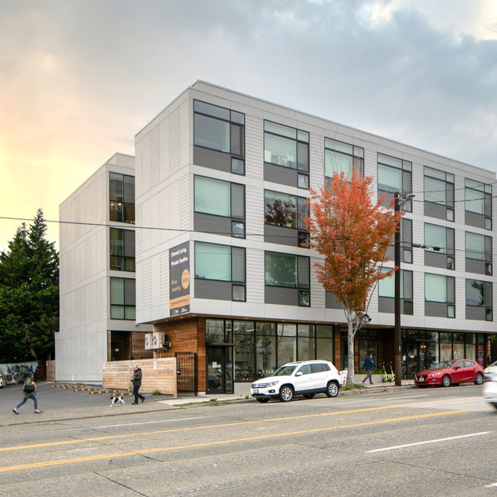
More affordable forms of housing
Townhomes and row houses
Off-site construction
Co-living (a-podments)
Shared housing (renting a room)
Subsidized housing (using any or all the incentives possible)
Naturally occurring (older)
Deeply subsidized
Notes:
Unit size: Can’t require room dimensional standards larger than that required by the state building code
Density: Sleeping unit in co-living housing can’t be counted as more than one-quarter of a dwelling unit or less when calculating dwelling unit density
Parking: No parking within ½ mile walking distance of major transit stop. No more than 0.25 off-street require parking spaces per sleeping unit
Fees: Sleeping unit in co-living housing can’t be counted as more than one-half of a dwelling unit when calculating fees for sewer connections
No more restrictive standards than for other housing types. No review/ noticing procedures not required for similar housing types in same zone.
May not require co-living housing to provide a mix of unit sizes or number of bedrooms, or to include other uses

Slide 9
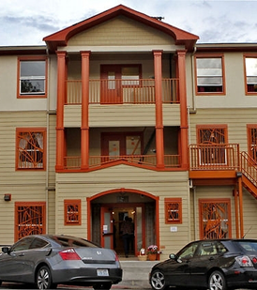
STEP housing (shelters, transitional, emergency and permanent supportive housing)
Allow STEP in specified zones
PSH and transitional housing in zones that allow residential uses and hotels
Emergency housing and shelter in zones that allow hotels or >50% of zones within a mile of transit
Siting restrictions must have a public health and safety connection
Reasonable occupancy, spacing, and intensity of use requirements may be imposed to protect public health and safety.
Restrictions must still allow sufficient capacity to accommodate projected needs for these types of units (under RCW 36.70A.070(2)(a)(ii))
Statutes: RCW 35A.21.430, RCW 35.21.683, RCW 36.70A.070(2) adopt with periodic update.

Slide 10
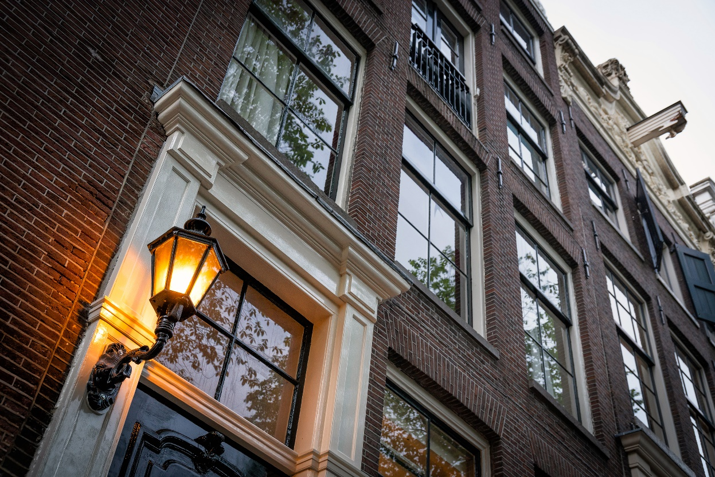
Conversion of existing buildings for housing
Allow housing units constructed entirely within the envelope of an existing building at a density 50% greater than allowed by the underlying zone
For buildings zoned for commercial or mixed use, in zones that allow multifamily housing
Do not require additional parking for new residential units May require retention of existing parking
Require design standards and permitting requirements no greater than those for similar residential developments in the zone
This includes setbacks, lot coverage requirements, etc.
Statutes: RCW 35.21.990, RCW 35A.21.440, must adopt by 6 monts after update

Slide 11
How do you keep it affordable?
Annual income limits set by HUD
For many programs, building owner must conduct annual certification of incomes (narrow band of who can afford)
For community land trust, a covenant runs with the land, reviewed at resale (limited equity)
Local government monitoring and audits (or the state can help)
What happens when incomes rise?

Slide 12

Adding to Our Housing Supply Helps Achieve Affordability
“
The good news is that success is possible. We can have the new housing we need, and we can do it without having to sacrifice the things that make our neighborhoods and our cities so special.”
Sam Pace
South King County Housing Specialist
Seattle King County Realtors

Slide 13
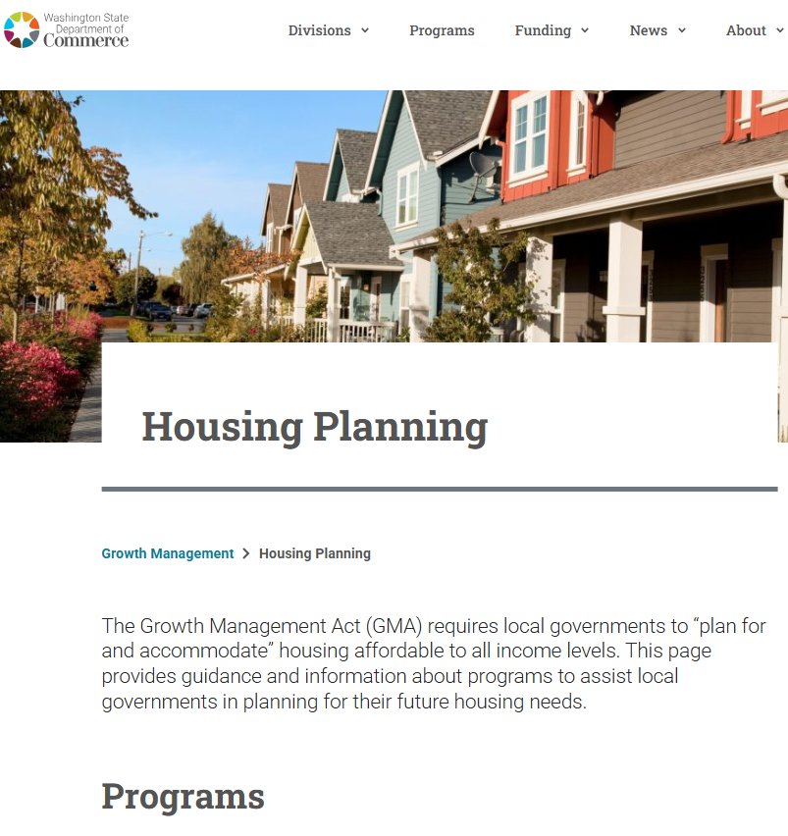
Commerce housing pages
www.commerce.wa.gov/growth-management/housing-planning
MAIN PAGE
2019-2024 housing laws
Communications tools
Videos, PPTs, fact sheets on basic housing topics
Public opinion survey on housing results
UPDATING GMA HOUSING ELEMENTS
Periodic update expanded checklist for housing
Updating your housing element
STEP housing resources
MIDDLE HOUSING
ADU guidance
Middle housing resources
PPTs, videos, FAQs
Pro-forma and objective design standards
Multi-family Property Tax Exemption (MFTE)
MFTE information and resources

Slide 14
Questions?
Eric Guida
Position
Email
Phone

