Slide 1
New laws for housing planning
Comprehensive planning
Implementing
regulations
Incentives for housing
Eric Guida, Regional Planner
Anne Fritzel, Housing Section Manager
Katherine Mitchell, MFTE Program Manager
Growth Management Services
July 21, 2025
Notes:
Thank you for inviting us here this evening to discussing housing both in Washington state at the big picture level and then more specifically in Gig Harbor at the local level. Survey after survey over the last several years has told us the housing and housing affordability is one of the biggest concerns in the state. And to begin to address that concern the legislature has passed legislation that requires that cities and counties play a role in addressing housing affordability. The diagram on this slide shows that local governments need to start with comprehensive planning, at the goal or policy level, and then implement with specific development regulations and must also can look to intencives to support types of housing that the market isn’t creating.

Slide 2
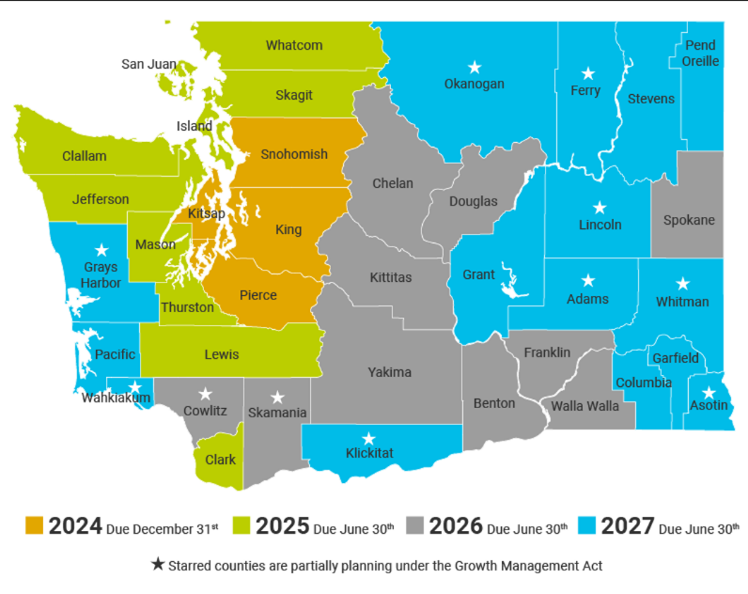
Growth Management Act (GMA) requires that comprehensive plans and development regulations be updated every 10 years
Notes:
I used the phrase comprehensive planning, and so I need to take a little time to explain what I mean by that. In 1990, Washington State put in place the Growth Management Act. In the recital to this legislation, the GMA reads, “The legislature finds that uncoordinated and unplanned growth, together with a lack of common goals expressing the public's interest in the conservation and the wise use of our lands, pose a threat to the environment, sustainable economic development, and the health, safety, and high quality of life enjoyed by residents of this state.” A number of elements are required, including Land Use, Housing, Transportation, Capital Facilities, and Infrastructure. When adopted, plans are considered valid unless appeals, or the update to the plan and regulations is not completed on time. Then the plan is considered out of compliance, and the jurisdiction is not eligible to receive grants and loans.
These plans must be updated every 10 years on a rolling schedule, to plan for the next 20 years.

Slide 3
Updated GMA goal for housing
Encourage Plan for and accommodate housing affordable to all economic segments of the population of this state,
Promote a variety of residential densities and housing types, and
Encourage preservation of existing housing stock.
RCW 36.70A.020(4)
amended by HB 1220 in 2021
Notes:
In 2021, in House bill 1220, the language for the housing goal went from a very light statement about encouragement , to an affirmative statement that the city must plan for and accommodate housing for all economic segments of the population. Gig Harbor, the local government, does not have to create any housing, but does have to plan for and accommodate housing affordable for all economic segments. Under what conditions can the development environment support a range of housing to so that housing is at least possible at the range of income levels?

Slide 4
Updated housing element requirements
Local housing element to:
Conduct an inventory and analysis of all housing needs by income level, including permanent supportive housing (PSH) and emergency housing
Identify sufficient capacity of land for identified housing needs for all income levels
Include policies for middle housing
Make adequate provisions for all housing needs, including documenting programs and actions needed to achieve housing availability such as gaps in local funding, development regulations, etc.
Address racially disparate impacts, displacement, exclusion and displacement risk in housing through policies and regulations
RCW 36.70A.070(2)
amended by HB 1220 in 2021
Notes:
This slide is about the specifics of what a Housing Element can and should to be make housing possible across the range of incomes.
-The bill requires Commerce to provide specific projections of housing need for moderate, low, very low and extremely low income segments, and for emergency housing and permanent supportive housing needs.
-
The requirements for the local housing elements have been updated to include:
--an inventory and analysis of housing needs at all income brackets as provided by Commerce,
--identifying sufficient land capacity for all housing needs including those for the specific housing needs by income bracket,
--the section on “make adequate provisions” which is covered on the next slide.

Slide 5
Adequate provisions
RCW 36.70A.070(2)(d): “The housing element makes adequate provisions for existing and projected needs of all economic segments of the community, including:”
Incorporating consideration for low, very low, extremely low, and moderate-income households;
Documenting programs and actions needed to achieve housing availability including gaps in local funding, barriers such as development regulations, and other limitations;
Minimum requirements:
Identify where housing production is not meeting local housing needs
Identify factors within the control of the local government that are barriers to needed housing
Review zoning regulations (setbacks, heights, parking, etc.)
Review permitting processes and fee structures
Review availability of capital facilities
Consider full range of incentives to encourage housing.
Notes:
Adequate provisions means identifying factors within the control of the local government that are barriers to housing development and undoing them to allow the POTENTIAL that the needed housing can be developed.
For example:
Review zoning regulations (setbacks, heights, parking, etc.), permitting processes, fee structures, incentives, etc. which influence housing
Consider various incentive programs, or evaluate what local funding options have been authorized to support affordable housing
This step is important to helping the market meet your needs.

Slide 6
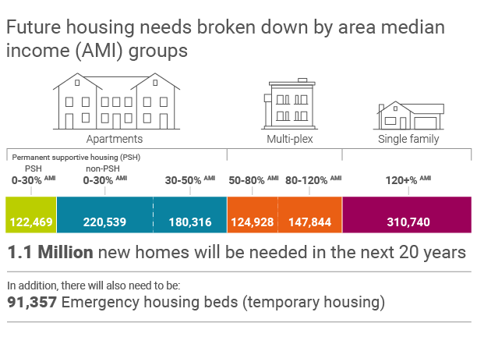
Commerce to project statewide housing need We need 1.1 million new homes (over 20 years)
How did we get projections?
From the OFM medium population projection for each county, considering:
Group quarters
Persons per household
Vacancy rate
Second homes
Census income data
Risk of homelessness
We also need 91,357 emergency housing beds over the next 20 years.
www.commerce.wa.gov/growth-management/housing-planning/housing-guidance/
Notes:
Speaking of needs, the other update to the housing element requirements of the GMA is that Commerce was to project housing needs for the state.
Projected housing needs were developed at a countywide level, using state population projections, and put through a model produced by Commerce, considering group quarters, future household size, a healthy vacancy rate, recreational housing (which is not part of the housing inventory), and risk of homelessness.
Overall, Washington will need to produce 1.1 million new homes in the next twenty or about 50,000 units per year.
As you can see, we have generally shown the housing type that corresponds to each income level.
At higher incomes, on the right, the private market will generally, and historically has produced single family detached housing.
In the middle, in orange, is middle income households, which is generally going to be multi-unit housing, such as duplexes, cottage housing, townhomes, etc. Here, the private market MAY be able to provide housing with the right mix of zoning and incentives, and support,
For lower income brackets, on the left, the private market is unlikely to provide this housing , and it will require subsidies and other support, In some cases, existing naturally occurring housing, such as mobile home parks, basement suites, or room rentals already provide this housing. However, For new deeply affordable housing, these are usually going to be apartment buildings.
What these numbers show us is that we will need to change the way we are currently planning for housing to provide the potential that housing affordable to residents of all incomes can be built. This means that most communities will need to zone for more multifamily housing, and likely more options for smaller lots and middle housing
Pierce county and the cities worked together to allocate countywide housing needs for each community. Our guidance says to consider land capacity, existing housing at each income band, and capital facilities, employment, transit and services.

Slide 7
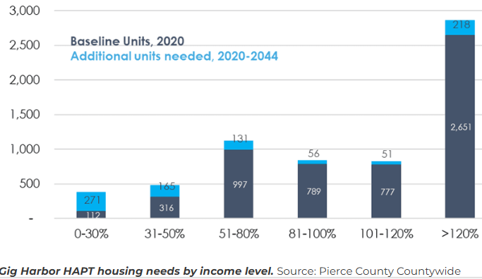
Notes:
This is the housing targets that Gig Harbor adopted as part of a countywide process , and these are pretty modest targets over 20 years. The total number of housing units in Gig Harbor as of 2020 is in dark blue, and then an additional 892 in lighter blue. The change this time, is that these are broken down by income level.
For 120% + the private market will easily take care of the 218 homes that are projected.
For 50-120% - possible that ADUs and duplex, cottage developments, co-living or townhouses may provide options, hopefully by the private market, but short-term incentives such as the multifamily tax exemption may be needed to reach these housing targets
For the 436 ununder 50% AMI, these are generally built by non-profits, and these organizations need all the help they can get. Later we talk about a list of incentives and other adequate provisions to reach these targets, this is only abut 25 units per year.

Slide 8
Required development regulations for housing:
Optional and

Slide 9
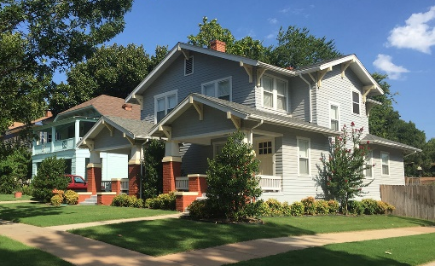
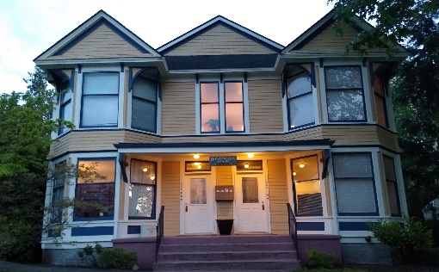
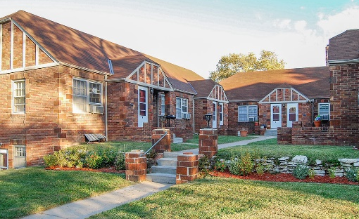
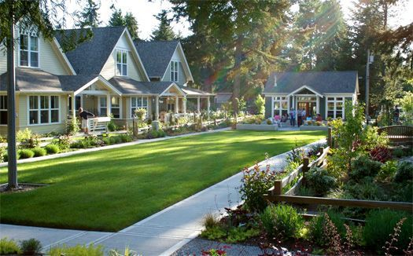
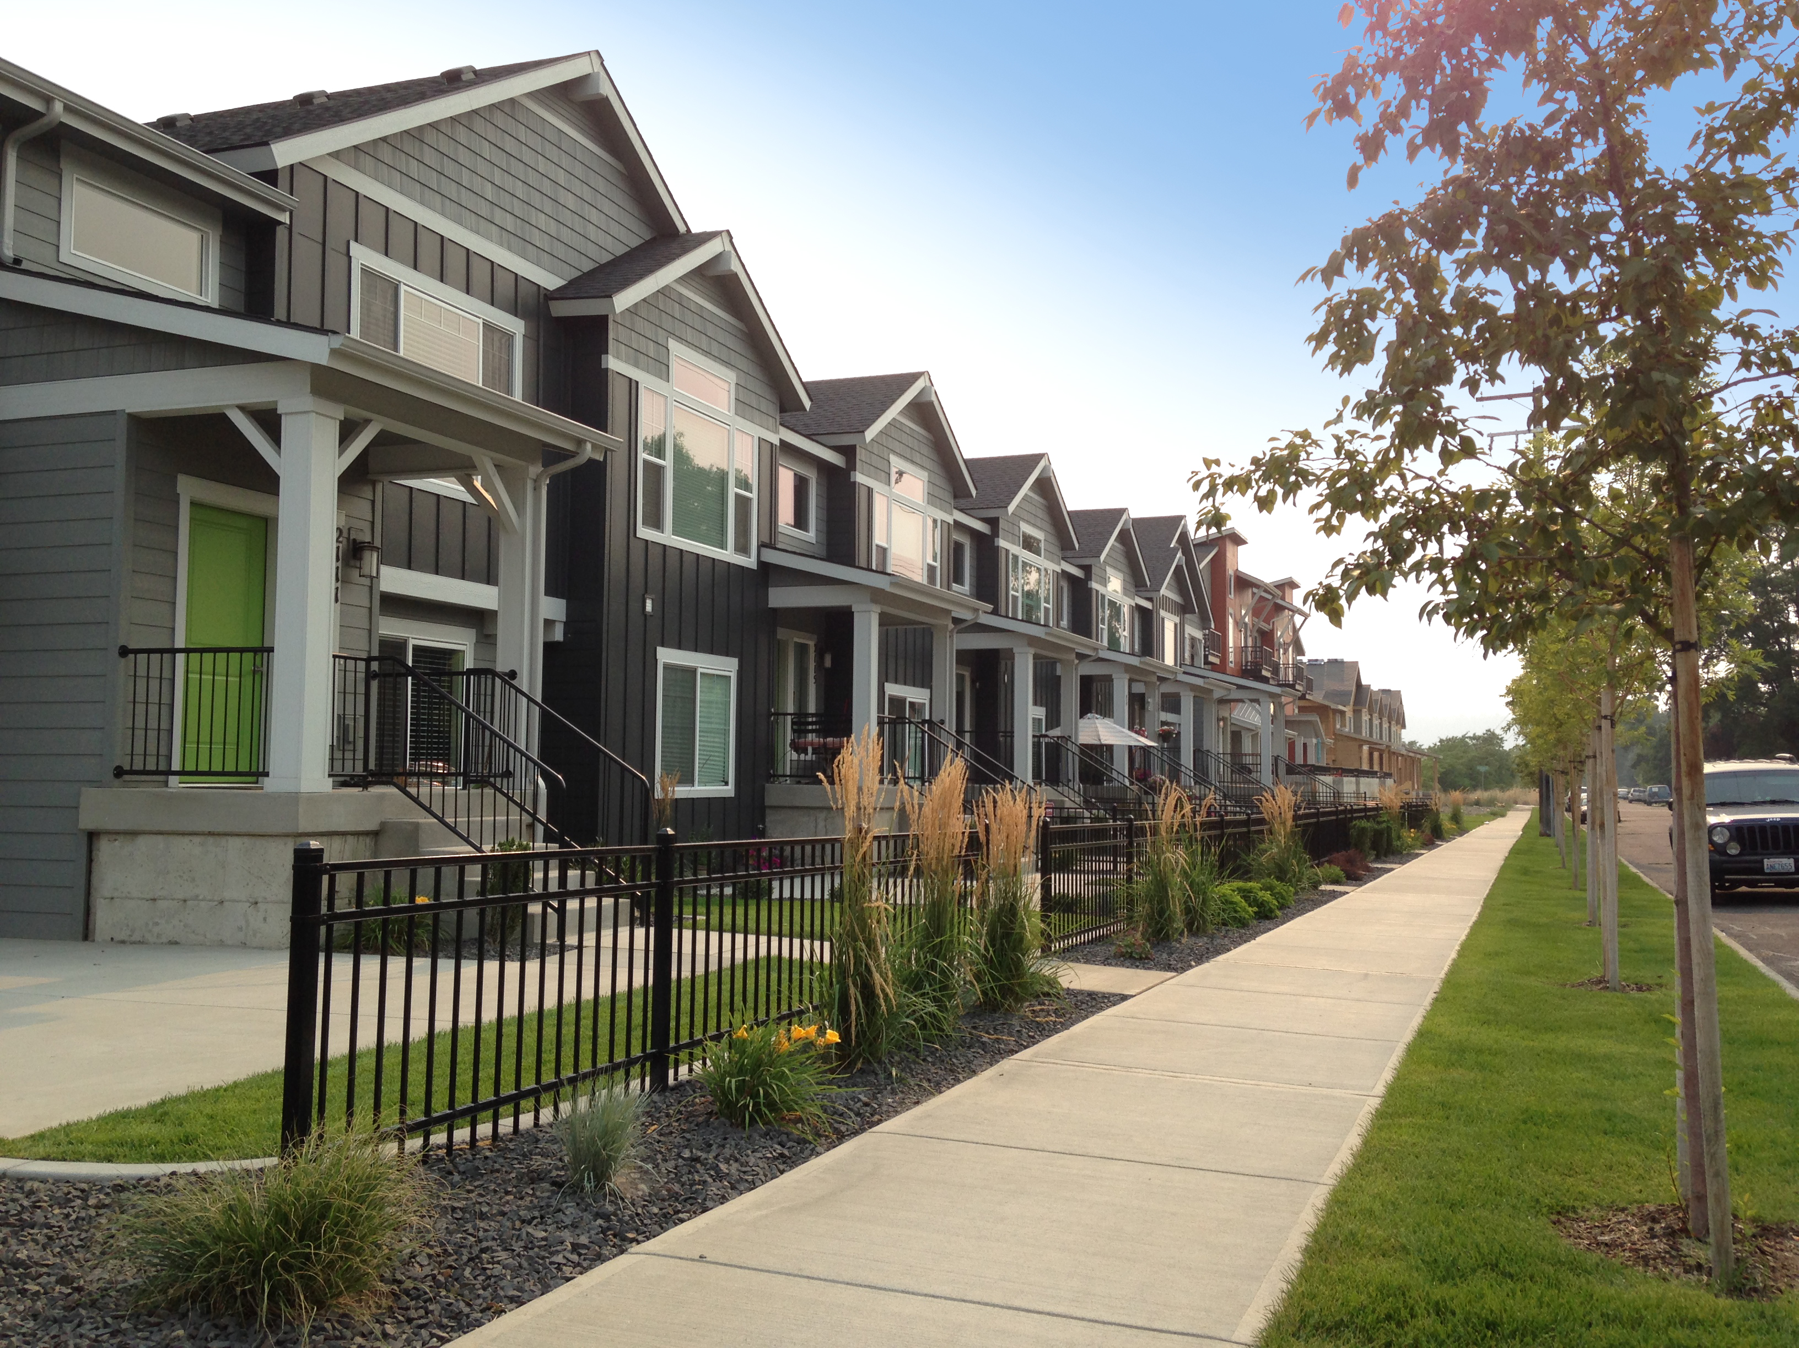
New laws to allow infill development
Must allow 2 ADUs per lot (where applicable)
Must allow middle housing (only policies required for Gig Harbor)
Must allow unit lot subdivisions (separate sale of middle housing or ADUs)
Must allow co-living (SROs) where zoning is 6 units per lot
Notes:
These are all passed in the last 5 years, and local governments must adopt within their regulations. These are pretty light policies, expect maybe 10% of lots over 20 years for ADUs, less for middle housing in existing neighborhoods (tear down or empty lot).

Slide 10
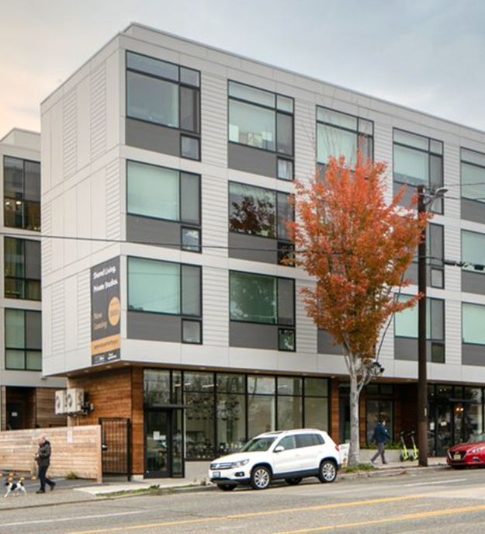
New laws to make it easier for development to happen
Enough sufficiently zoned land, in the right place, for all housing needs. (land capacity in comp plan)
Limits on the amount of parking that can be required
Time limits for permit processing
Proportionate impact fees
Clear and objective design standards
Adequate capital facilities (water and sewer capacity and piping)

Slide 11
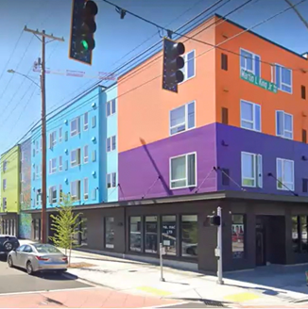
New laws to make it easer for affordable housing
Adequate provisions for housing for all economic segments
Must allow permanent supportive housing (PSH), transitional and emergency housing and shelters
May not regulate the number of people in a home
Must allow conversion of existing buildings to residential

Slide 12
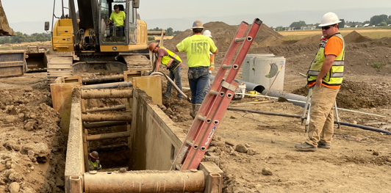
Optional incentives for affordable housing
Bonus densities for affordable housing
Free or reduced cost land
For community land trusts or affordable rental housing
Utility extensions to underserved land
Sewer, water or regional stormwater
Expedited project review
For affordable housing
Reduced or waived utility connection fees
Grants or loans
Notes:
Incentives are certainly part of the adequate provisions. You don’t have to adopt them all, but you should include enough in local programs to allow the potential that all of the needed housing can be built.

Slide 13

When do you know you have done enough?
Statewide review of housing production
Annual review of housing production by level of affordability (WCRER)
Housing Accountability Act (SB 5148 – laws 2025)
Voluntary certification of housing planning
Commerce review if underperforming or minimum requirements are not met
If found out of compliance, may not deny or impose adverse conditions on affordable or moderate-income housing projects
You have enough zoned land capacity
You are removing barriers in your regulations
Incentives are being evaluated and adopted
New housing is being built!
Notes:
Voluntary certification – means housing element or regulations.
Commerce makes the determination of grants and loans – must allow affordable housing development. . .

Slide 14
MFTE as an incentive
Optional and
Notes:
Not required, but want to select some to show adequate provisions

Slide 15
MFTE is part of the spectrum of housing solutions
MFTE is a
tool in the
housing solutions toolbox
Housing Trust Fund, WS Housing Finance Commission and other programs support the development of deeply affordable housing at greater expense
MFTE incentivizes units for low and moderate incomes, as well as
market-rate units
Notes:
The state needs 1.1 million new homes over the next 20 years, and the legislature has created wide spectrum of programs to address all aspects of the housing need.
Programs like Housing Trust Fund use public funds to address the need for permanent supportive housing at the deepest levels of affordability. MFTE leverages private market funds, incentivizing development in the middle of this affordability spectrum, and is a widely-utilized part of the toolbox to meet our goals.

Slide 16
MFTE is significantly more affordable than a direct subsidy
MFTE incentivizes units for low and moderate incomes, as well as
market-rate units
$2,004
$93,555
Average year 1 exemption per new unit, 2023 MFTE Annual Report
Average state subsidy for a new Housing Trust Fund-supported unit, 2023 report
The Housing Trust Fund and other programs create deeply affordable housing at greater expense
Notes:
Though you can’t get the same level of affordability from leveraging private investment, MFTE is extremely efficient at producing housing compared to other methods of government support for housing.

Slide 17
MFTE’s limited cost does not reduce revenue, and new projects bring positive tax impacts
MFTE does not result in a reduction of revenue for the jurisdiction. A tax shift occurs, where the value of exemptions are evenly distributed to other parcels
New MFTE residential development also results in increases in other local revenue:
Sales taxes from construction
Real estate excise taxes (REETs)
Impact fees, connection charges, and other fees
Non-exempt property taxes
Increases in state-shared revenue
Increases in local sales and business and occupation (B&O) taxes from resident spending
After the exemption expires, new construction remains, paying full value.
Notes:
MFTE does not result in a reduction of revenue for the jurisdiction. A tax shift occurs, where property is assessed at new construction values and then removed from the rolls and the value of exemptions are paid by other property owners. We’ll discuss tax shift in greater detail later on.
It’s important to note that MFTE programs typically have a positive impact on the local tax base in the long term. The City of Tacoma has told Commerce that they have come out positive on every exemption issued under the MFTE program. This is because projects increase revenue in many ways:
Taxable construction activities related to projects supported by MFTE will remit sales taxes to state, city and county governments.
Upon sale, rental and owner-occupied MFTE units will pay excise taxes to state and local governments. This will cover not only initial sales upon the completion of construction, if applicable, but also future sales.
While not "tax revenue" per se, MFTE projects will also be responsible for impact fees, connection charges, and other development fees charged by a community. For projects that include affordable housing, local governments may have programs that provide partial or even full waivers of these charges as an additional incentive.
While the residential improvements on a site will be exempt, commercial components of buildings and underlying increases in property value will still be taxable. For mixed-use buildings or revitalization projects, this would represent an increase beyond a vacant site or a site with heavily depreciated improvements.
In addition to impacts related to the building itself, there are also local effects from sales taxes paid by the residents of new construction, and additional B&O taxes from new local businesses. Note that while both can be related to an increase in local business activity, higher sales taxes can also be received from online purchases charged at local points of sale.
Certain sources of state funding support for local jurisdictions may depend on local population (or in the case of school funding, local student enrollment). In these situations, an MFTE program that supports an increase in local population may adjust the results of these calculations.

Slide 18
Questions?
Eric Guida
Regional planner
Eric.Guida@commerce.wa.gov
Phone
www.commerce.wa.gov/planning-for-housing

